Slide 1

Joint Models for NLP
Yue Zhang
Westlake Institute for Advanced Study

Slide 2
Outline
Motivation
Statistical Models
Deep Learning Models

Slide 3
Outline
Motivation
Statistical Models
Deep Learning Models

Slide 4
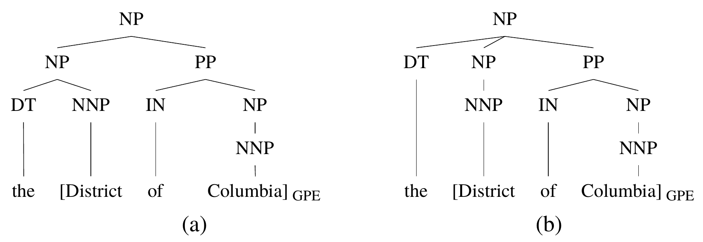
Motivation
Related tasks in NLP
Constituents and named entities

Slide 5
Motivation
Related tasks in NLP
NER, Chunking and POS Tagging
Sentence:
POS Tagging:
NER:
Chunking:
Joi | runs | the | MIT | Media | Lab | .
NNP | VBZ | DT | NNP | NNP | NNP | .
PER | O | O | B-ORG | I-ORG | I-ORG | O
S | S | S | B | I | E | O

Slide 6
Motivation
Pipelines in NLP
Segmentation POS tagging
布朗访问上海
布朗/ 访问/ 上海/
布朗/NR 访问/VV 上海/NR

Slide 7
Motivation
Pipelines in NLP
Entity and Relation
sentence
Associated Press writer Patrick McDowell in Kuwait City
NER
Associated Press
writer
Patrick McDowell
in
Kuwait City
ORG
PER
GPE
ORG-AFF
PHYS
RELATION
Associated Press
writer
Patrick McDowell
in
Kuwait City
ORG
PER
GPE

Slide 8
Motivation
Pipelines in NLP
Entity and Sentiment
sentence
So excited to meet my baby Farah !!!
NER
So excited to meet my [baby Farah] !!!
PER
Sentiment
So excited to meet my [baby Farah]+ !!!
PER + POSITIVE

Slide 9
Motivation
Joint model
Reduce error propagation
Allow information exchange between tasks
Challenge
Joint learning
Search

Slide 10
Solutions
Learning
 | Joint | Separate
Joint | Statistical Neural | Statistical
Separate | Neural
Search

Slide 11
Outline
Motivation
Statistical Models
Deep Learning Models

Slide 12
Statistical Models
Graph-Based Methods
Transition-Based Methods

Slide 13
Statistical Models
Graph-Based Methods
Transition-Based Methods

Slide 14
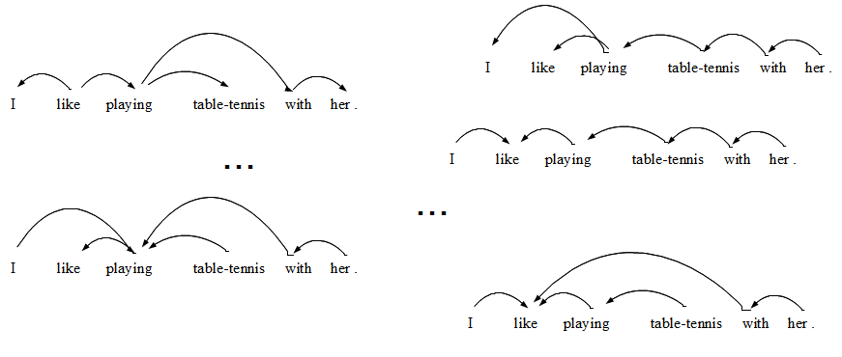
Graph-Based Methods
Traditional solution
Score each candidate, select the highest-scored output
Search-space typically exponential

Slide 15
Graph-Based Methods
Joint Label Structure
Reranking
Joint Modeling (Multi task)
Joint Modeling (Single task)

Slide 16
Graph-Based Methods
Joint Label Structure
Reranking
Joint Modeling (Multi task)
Joint Modeling (Single task)

Slide 17
Graph-Based Methods
Joint Label Structure
Reranking
Joint Modeling (Multi task)
Joint Modeling (Single task)
Joint Search
,
Joint Learning

Slide 18
Joint Segmentation and POS tagging
Tasks
POS
Tagger
Words
Segmenter
Characters
Input

Slide 19
Joint Segmentation and POS tagging
Task
Segmentation
布朗 访问 上海
NN VV NN
POS Tagging
Ng, Hwee Tou, and Jin Kiat Low. "Chinese part-of-speech tagging: One-at-a-time or all-at-once? word-based or character-based?." EMNLP. 2004.

Slide 20
Joint Segmentation and POS tagging
Collapsing labels
BE BE BE
布朗 访问 上海
NN VV NN
B-NN E-NN B-VV E-VV B-NN E-NN
布 朗 访 问 上 海
Ng, Hwee Tou, and Jin Kiat Low. "Chinese part-of-speech tagging: One-at-a-time or all-at-once? word-based or character-based?." EMNLP. 2004.

Slide 21
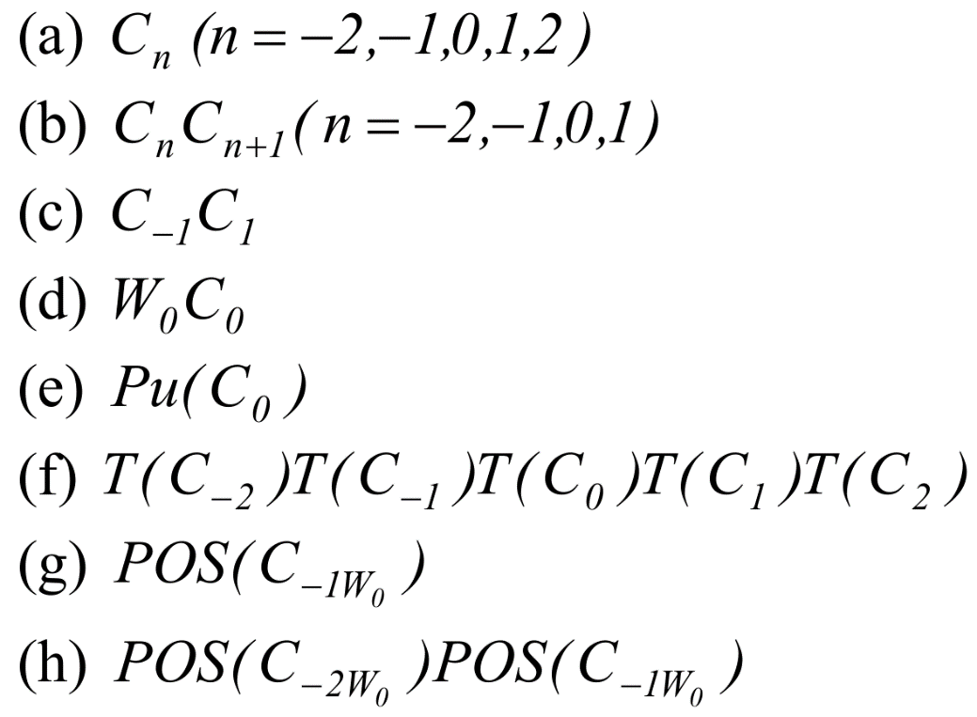
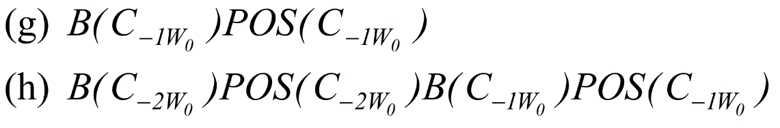
Joint Segmentation and POS tagging
All-at-Once, Character-Based POS Tagger and Segmenter : Feature
Ng, Hwee Tou, and Jin Kiat Low. "Chinese part-of-speech tagging: One-at-a-time or all-at-once? word-based or character-based?." EMNLP. 2004.

Slide 22
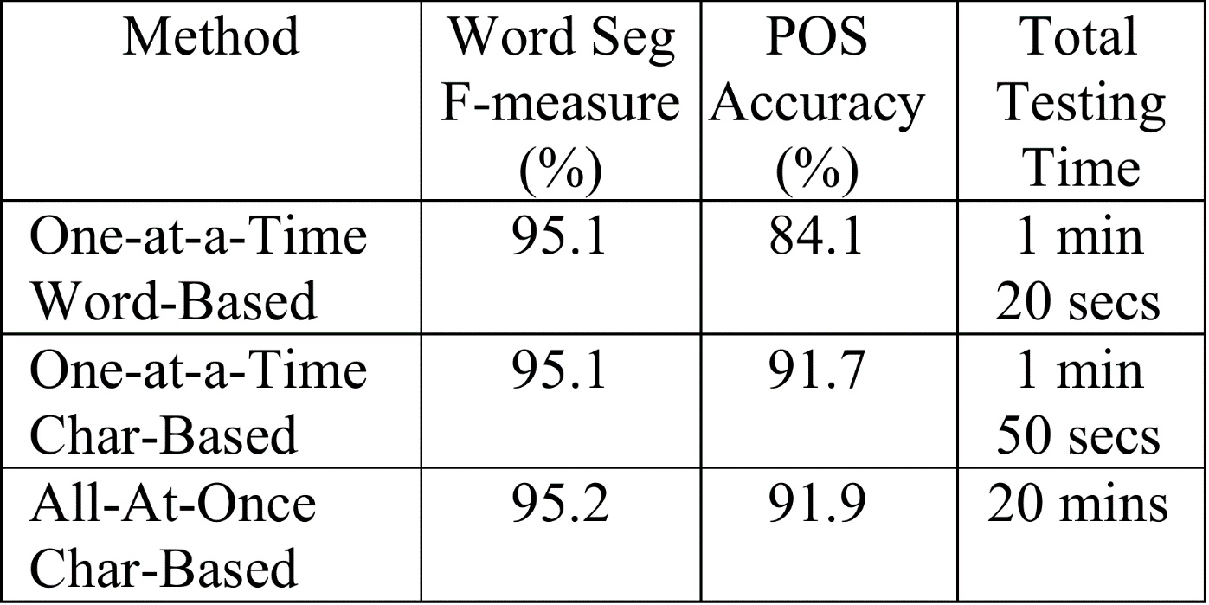
Joint Segmentation and POS tagging
Results on CTB
Ng, Hwee Tou, and Jin Kiat Low. "Chinese part-of-speech tagging: One-at-a-time or all-at-once? word-based or character-based?." EMNLP. 2004.

Slide 23
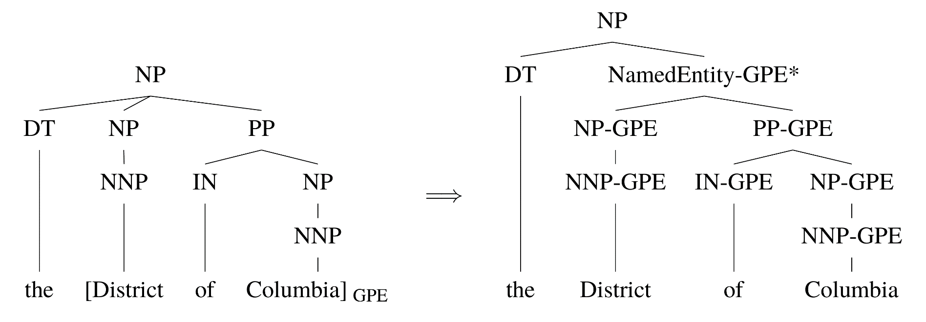
Joint Parsing and NER
A joint model of both parsing and named entity recognition.
Finkel, Jenny Rose, and Christopher D. Manning. "Joint parsing and named entity recognition." Proceedings of Human Language Technologies: The 2009 Annual Conference of the North American Chapter of the Association for Computational Linguistics. Association for Computational Linguistics, 2009.

Slide 24
Joint Parsing and NER
A feature-based CRF-CFG parser operating over tree structures augmented with NER information.
Finkel, Jenny Rose, and Christopher D. Manning. "Joint parsing and named entity recognition." Proceedings of Human Language Technologies: The 2009 Annual Conference of the North American Chapter of the Association for Computational Linguistics. Association for Computational Linguistics, 2009.

Slide 25
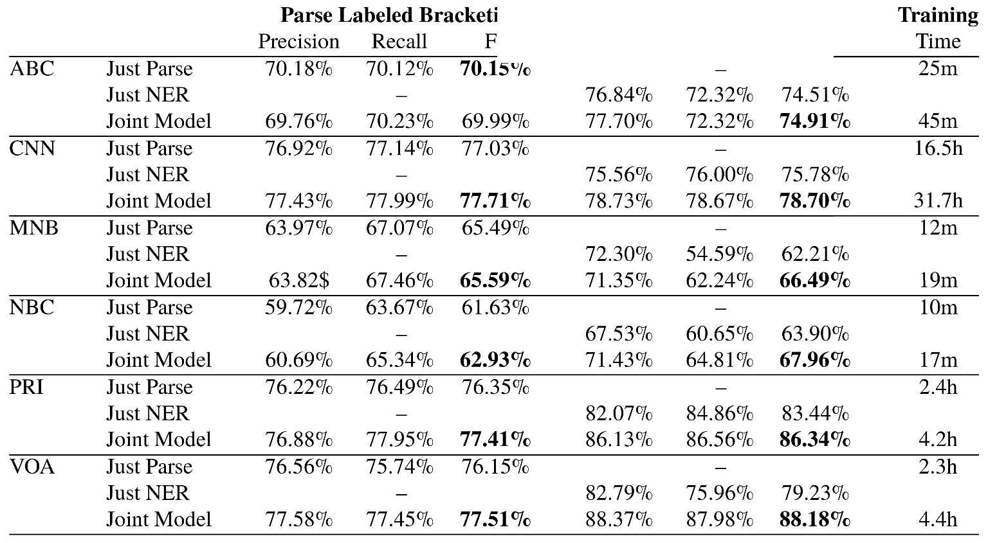
Joint Parsing and NER
Results:
On OntoNotes
Finkel, Jenny Rose, and Christopher D. Manning. "Joint parsing and named entity recognition." Proceedings of Human Language Technologies: The 2009 Annual Conference of the North American Chapter of the Association for Computational Linguistics. Association for Computational Linguistics, 2009.

Slide 26
Graph-Based Methods
Joint Label Structure
Reranking
Joint Modeling (Multi task)
Joint Modeling (Single task)

Slide 27
Graph-Based Methods
Joint Label Structure
Reranking
Joint Modeling (Multi task)
Joint Modeling (Single task)
Joint Search
,
Separate Learning

Slide 28
Joint Segmentation and POS Tagging
Two separate CRF taggers.
Separately trained, reranking.
Use tag sequence score to rank segmentation.
Shi, Yanxin, and Mengqiu Wang. "A Dual-layer CRFs Based Joint Decoding Method for Cascaded Segmentation and Labeling Tasks." IJcAI. 2007.

Slide 29
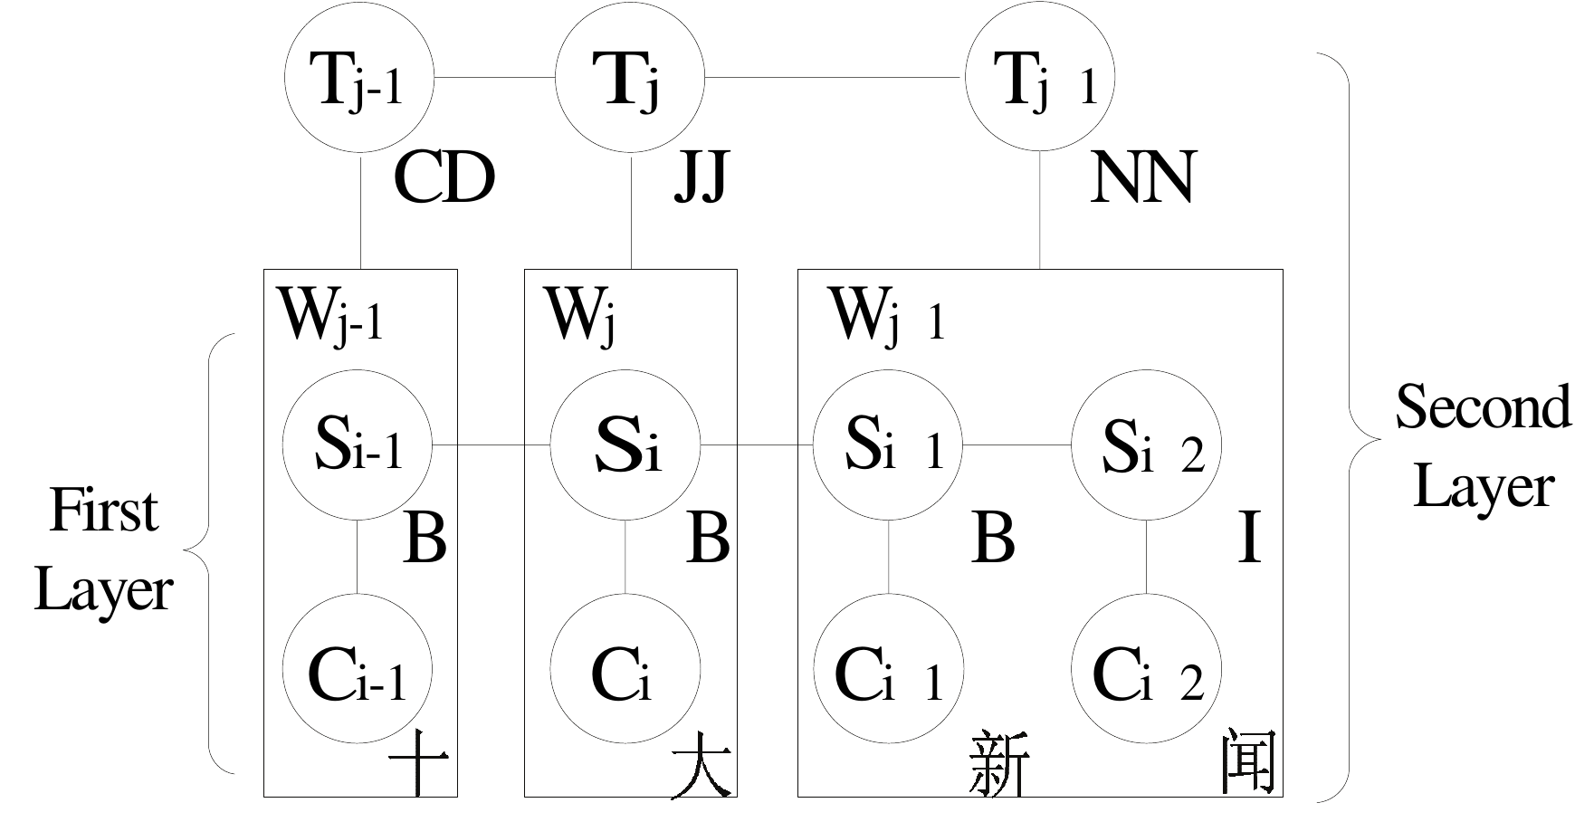
Joint Segmentation and POS Tagging
Dual-layer CRFs
Shi, Yanxin, and Mengqiu Wang. "A Dual-layer CRFs Based Joint Decoding Method for Cascaded Segmentation and Labeling Tasks." IJcAI. 2007.

Slide 30
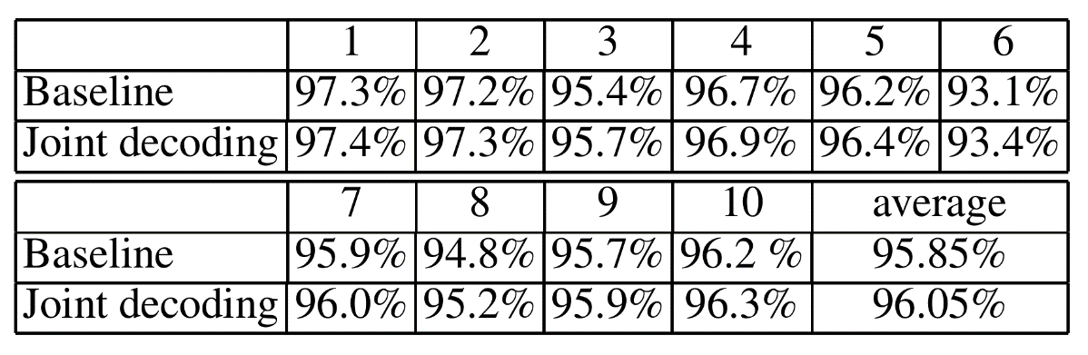
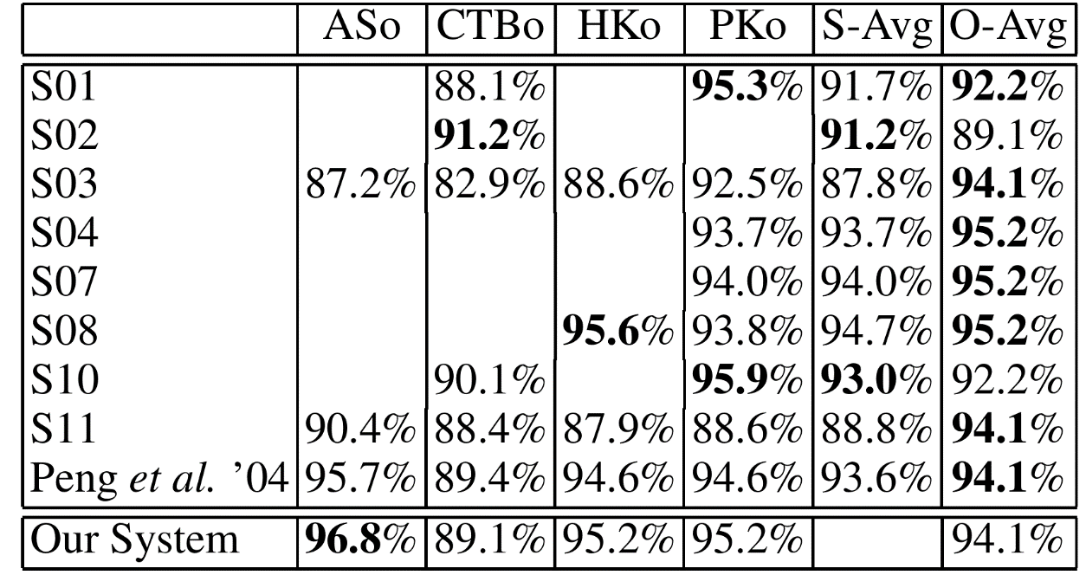
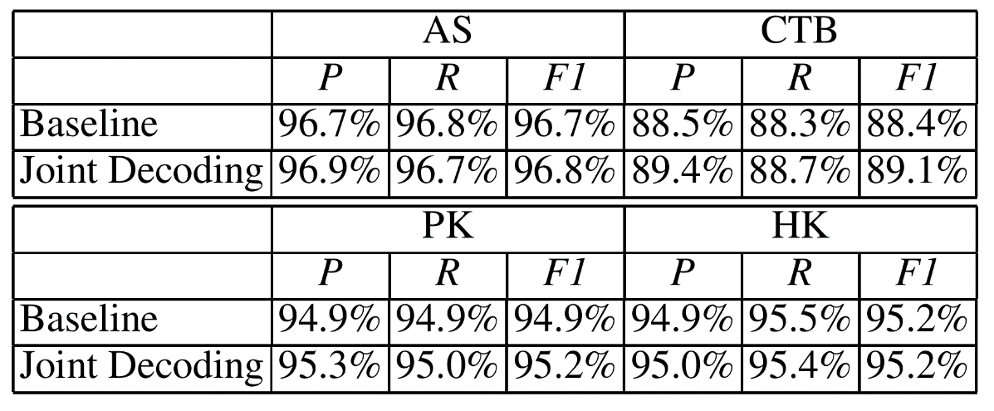
Joint Segmentation and POS Tagging
Results on Segmentation
Shi, Yanxin, and Mengqiu Wang. "A Dual-layer CRFs Based Joint Decoding Method for Cascaded Segmentation and Labeling Tasks." IJcAI. 2007.

Slide 31
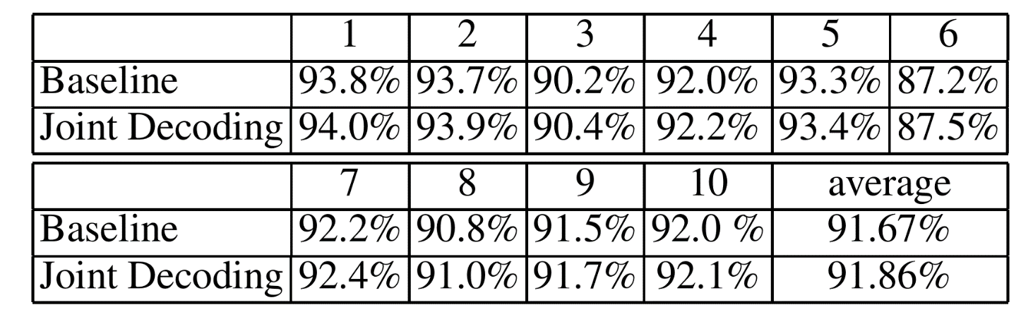
Joint Segmentation and POS Tagging
Results on POS Tagging
Shi, Yanxin, and Mengqiu Wang. "A Dual-layer CRFs Based Joint Decoding Method for Cascaded Segmentation and Labeling Tasks." IJcAI. 2007.

Slide 32
Joint Parsing and SRL
Task
Semantic Roles
SRL
Syntax
Parser
Input
Sutton, Charles, and Andrew McCallum. "Joint parsing and semantic role labeling." Proceedings of the Ninth Conference on Computational Natural Language Learning. Association for Computational Linguistics, 2005.

Slide 33
Joint Parsing and SRL
Rerank k-best parse trees from a probabilistic parser using an SRL system.
Sutton, Charles, and Andrew McCallum. "Joint parsing and semantic role labeling." Proceedings of the Ninth Conference on Computational Natural Language Learning. Association for Computational Linguistics, 2005.

Slide 34
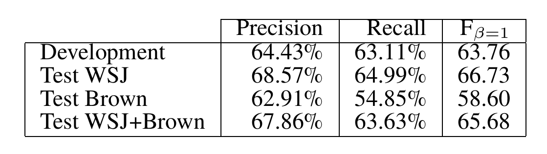
Joint Parsing and SRL
Overall results
Did not beat a pipeline baseline
Many subsequent CoNLL shared tasks show difficulties for this joint task
Sutton, Charles, and Andrew McCallum. "Joint parsing and semantic role labeling." Proceedings of the Ninth Conference on Computational Natural Language Learning. Association for Computational Linguistics, 2005.

Slide 35
Graph-Based Methods
Joint Label Structure
Reranking
Joint Modeling (Multi task)
Joint Modeling (Single task)

Slide 36
Graph-Based Methods
Joint Label Structure
Reranking
Joint Modeling (Multi task)
Joint Modeling (Single task)
Joint Search
,
Separate Learning

Slide 37
Joint Modeling
Joint Search, separate training
Search complex problem
ILP
BP
Dual Decomposition
Auli, Michael, and Adam Lopez. "A comparison of loopy belief propagation and dual decomposition for integrated CCG supertagging and parsing." Proceedings of the 49th Annual Meeting of the Association for Computational Linguistics: Human Language Technologies-Volume 1. Association for Computational Linguistics, 2011.

Slide 38
Joint Entity and Sentiment
Task:
Opinion linking relations
The numberic subscripts denote linking relations, one of IS-ABOUT OR IS-FROM
Opinion entities:
Opinion expressions: O
Opinion targets: T
Opinion holders: H
jointly identifies opinion-related entities, as well as opinion linking relations
[The workers]_{[H1,2]} were irked _{[O1]} by [the government report]_{[T1]} and were worried_{[O2]} as they went about their daily chores.
Yang, Bishan, and Claire Cardie. "Joint Inference for Fine-grained Opinion Extraction." ACL (1). 2013.

Slide 39
Joint Entity and Sentiment
Model
Formulate the task of opinion entity identification as a sequence labeling problem and employ conditional random fields (CRFs) to learn the probability of a sequence assignment y for a given sentence x;
Treat the relation extraction problem as a combination of two binary classification problems and use L1-regularized logistic regression to train the classifiers;
Optimize the joint objective function which is defined as a linear combination of the potentials from different predictors with a parameter λ to balance the contribution of these two components: opinion entity identification and opinion relation extraction.
Yang, Bishan, and Claire Cardie. "Joint Inference for Fine-grained Opinion Extraction." ACL (1). 2013.

Slide 40
Joint Entity and Sentiment
CRF
t₁
t₂
……
t_{n}
w₁
w₂
……
w_{n}
D – Opinion expression
T – Opinion target
H – Opinion Holder
N – Opinion None
Yang, Bishan, and Claire Cardie. "Joint Inference for Fine-grained Opinion Extraction." ACL (1). 2013.

Slide 41
Joint Entity and Sentiment
A classification model for opinion target relation
A classification model for opinion holder relation
Syntactic and semantic features are used
Yang, Bishan, and Claire Cardie. "Joint Inference for Fine-grained Opinion Extraction." ACL (1). 2013.

Slide 42
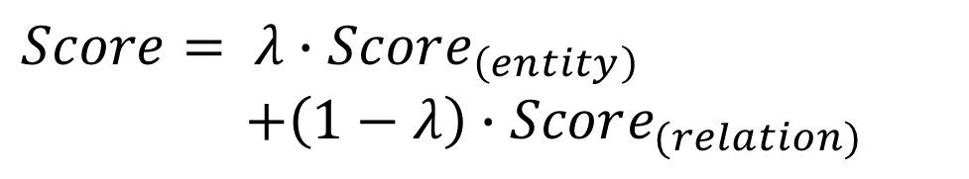
Joint Entity and Sentiment
Joint scoring function by linear interpolation
$$Score= λ∙Score_{\left(entity\right)}$$
$+\left(1−λ\right)∙Score_{(relation)}$
Yang, Bishan, and Claire Cardie. "Joint Inference for Fine-grained Opinion Extraction." ACL (1). 2013.

Slide 43
Joint Entity and Sentiment
ILP for search
Constraint 1: Uniqueness
Constraint 2: Non-overlapping
Constraint 3: Consistency between the opinion-arg and opinion-implicit-arg classifiers
Constraint 4: Consistency between opinion-arg classifier and opinion entity extractor
Constraint 5: Consistency between the opinion-implicit-arg classifier and opinion entity extractor
Yang, Bishan, and Claire Cardie. "Joint Inference for Fine-grained Opinion Extraction." ACL (1). 2013.

Slide 44
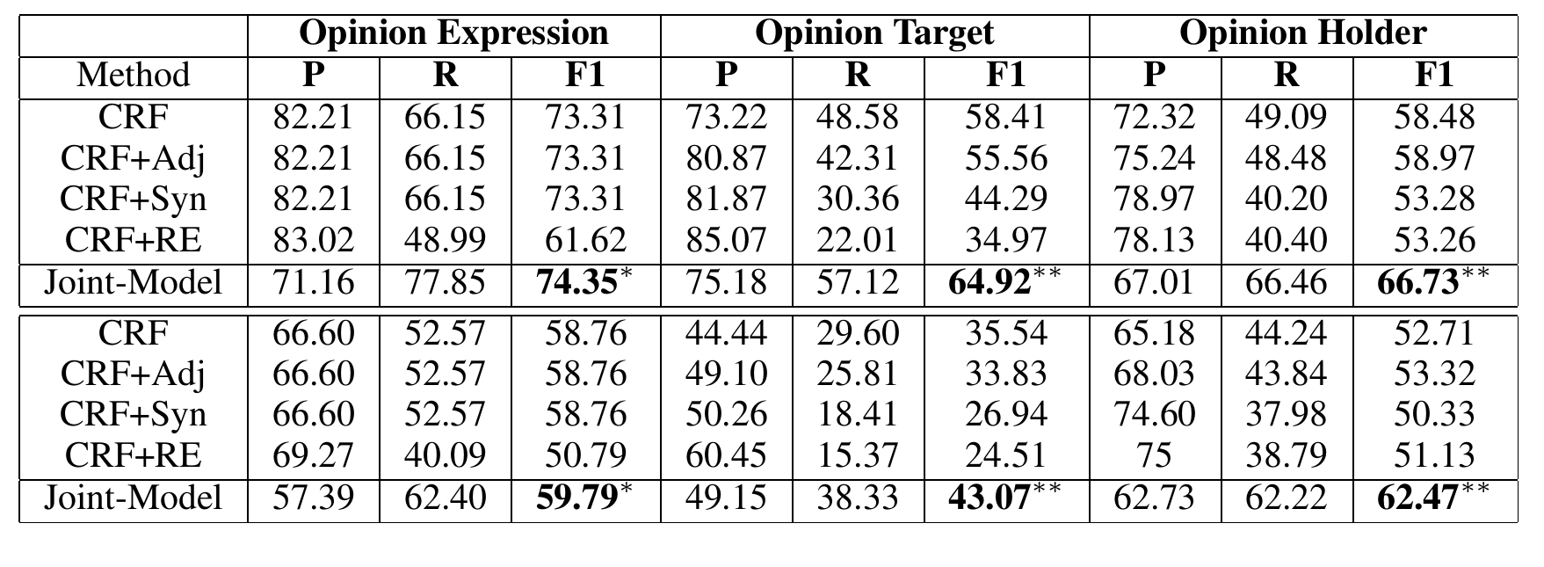
Joint Entity and Sentiment
Results on MPQA
Yang, Bishan, and Claire Cardie. "Joint Inference for Fine-grained Opinion Extraction." ACL (1). 2013.

Slide 45
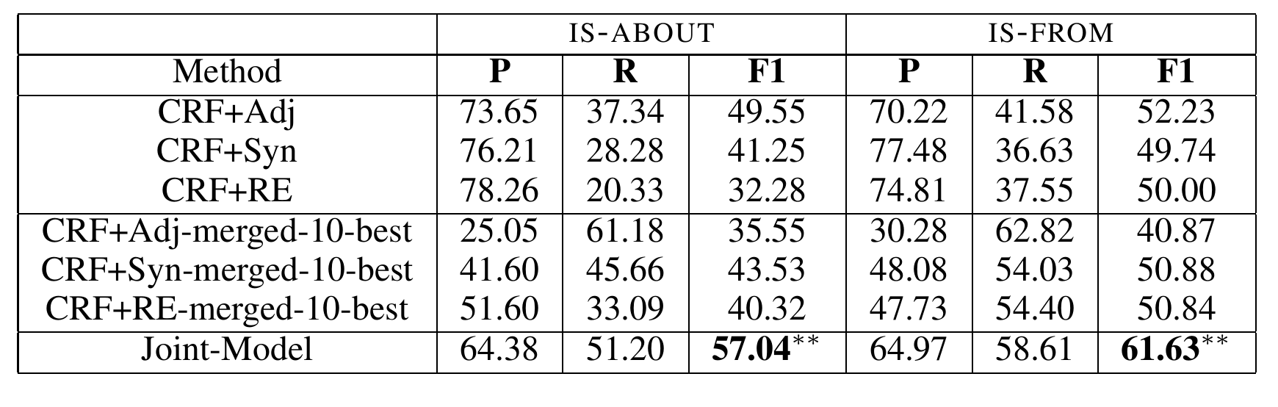
Joint Entity and Sentiment
Results on MPQA
Yang, Bishan, and Claire Cardie. "Joint Inference for Fine-grained Opinion Extraction." ACL (1). 2013.

Slide 46
Joint Supertagging and Parsing
Tasks
CCG Parsing
Parser
CCG Supertagging
Super tagger
Input

Slide 47
Joint Supertagging and Parsing
CCG parsing (for English, Chinese and other languages) is to find the syntactic structures of written text based on combinatory categorial grammars.
Marcel
proved
completeness
NP
(S\ NP)/NP
NP
S\ NP
S
Supper tagging and parsing
Auli, Michael, and Adam Lopez. "A comparison of loopy belief propagation and dual decomposition for integrated CCG supertagging and parsing." Proceedings of the 49th Annual Meeting of the Association for Computational Linguistics: Human Language Technologies-Volume 1. Association for Computational Linguistics, 2011.

Slide 48
Joint Supertagging and Parsing
CCG traditionally done by supertagging -> parsing
Auli, Michael, and Adam Lopez. "A comparison of loopy belief propagation and dual decomposition for integrated CCG supertagging and parsing." Proceedings of the 49th Annual Meeting of the Association for Computational Linguistics: Human Language Technologies-Volume 1. Association for Computational Linguistics, 2011.

Slide 49
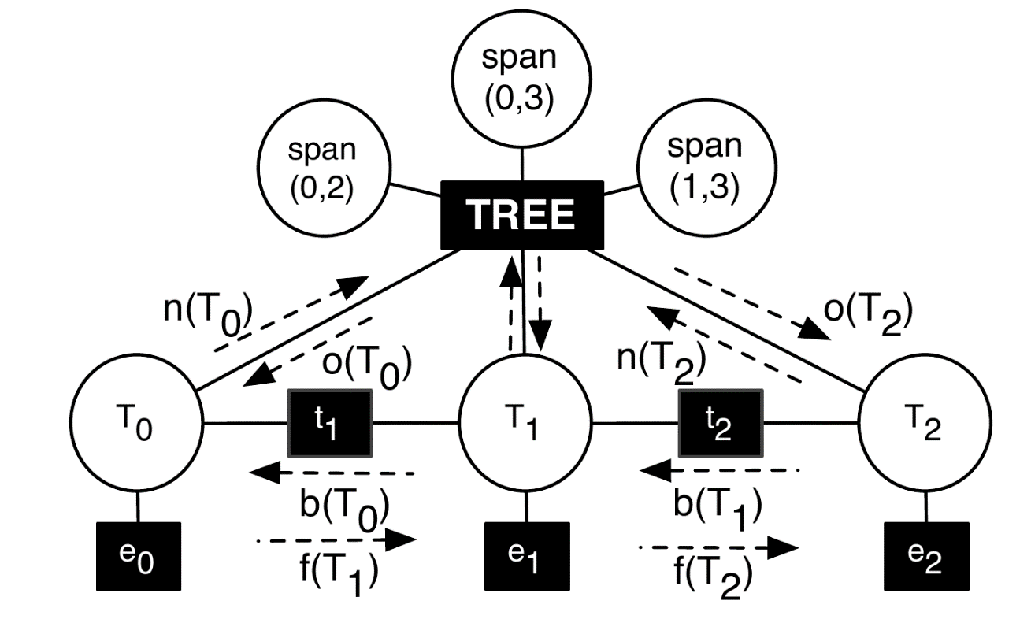
Joint Supertagging and Parsing
Loopy belief propagation
Factor graph for the combined parsing and supertagging model
Auli, Michael, and Adam Lopez. "A comparison of loopy belief propagation and dual decomposition for integrated CCG supertagging and parsing." Proceedings of the 49th Annual Meeting of the Association for Computational Linguistics: Human Language Technologies-Volume 1. Association for Computational Linguistics, 2011.

Slide 50
Joint Supertagging and Parsing
Dual decomposition: Lagrangian method for constraint optimization
Auli, Michael, and Adam Lopez. "A comparison of loopy belief propagation and dual decomposition for integrated CCG supertagging and parsing." Proceedings of the 49th Annual Meeting of the Association for Computational Linguistics: Human Language Technologies-Volume 1. Association for Computational Linguistics, 2011.

Slide 51
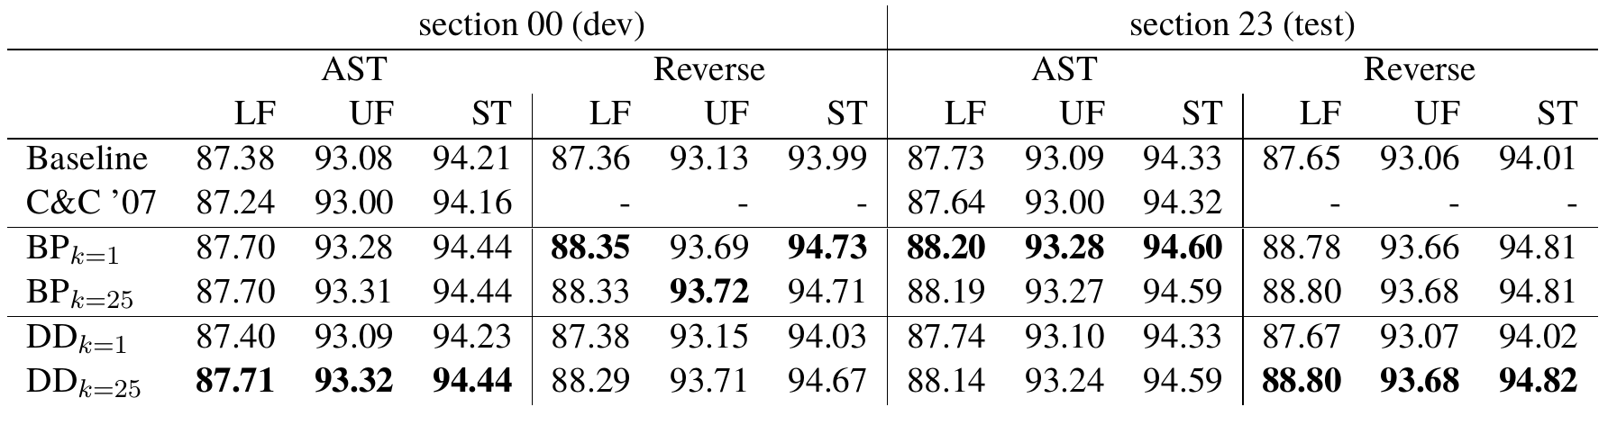
Joint Supertagging and Parsing
Results
BP: Belief Propagation
DD: Dual Decomposition
Auli, Michael, and Adam Lopez. "A comparison of loopy belief propagation and dual decomposition for integrated CCG supertagging and parsing." Proceedings of the 49th Annual Meeting of the Association for Computational Linguistics: Human Language Technologies-Volume 1. Association for Computational Linguistics, 2011.

Slide 52
Graph-Based Methods
Joint Label Structure
Reranking
Joint Modeling (Multi task)
Joint Modeling (Single task)

Slide 53
Graph-Based Methods
Joint Label Structure
Reranking
Joint Modeling (Multi task)
Joint Modeling (Single task)
Joint Search
,
Joint Learning

Slide 54
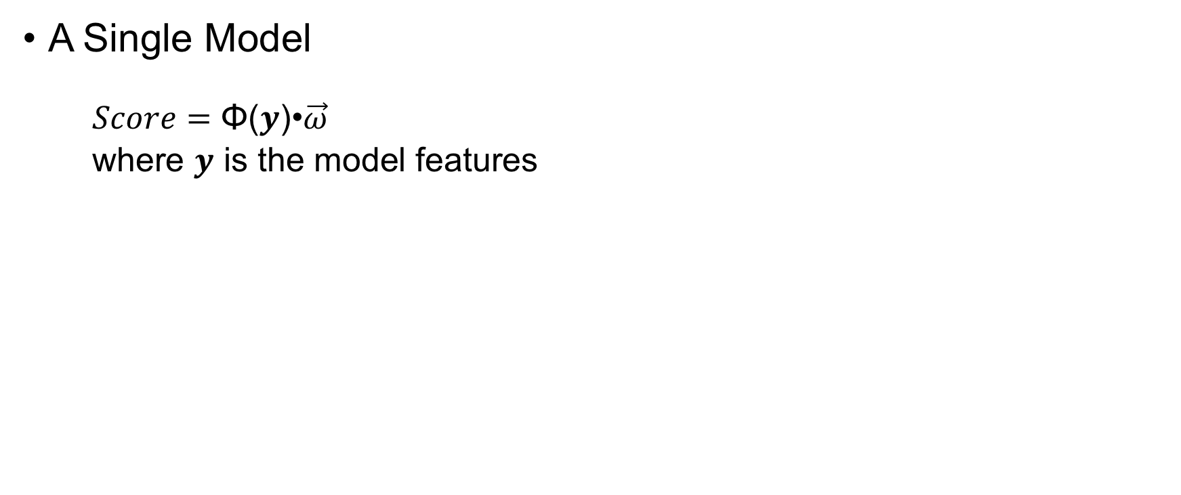
Joint Modeling (Single task)
A Single Model
$Score=\text{Φ}\text{(}y\text{)•}\vec{ω}$
where $y$ is the model features

Slide 55
Joint Segmentation and POS Tagging
Task
Input 我喜欢读书 Ilikereadingbooks
Output 我/PN 喜欢/V 读/V 书/N I/PN like/V reading/V books/N
Zhang, Yue, and Stephen Clark. "Joint Word Segmentation and POS Tagging Using a Single Perceptron." ACL. 2008.

Slide 56
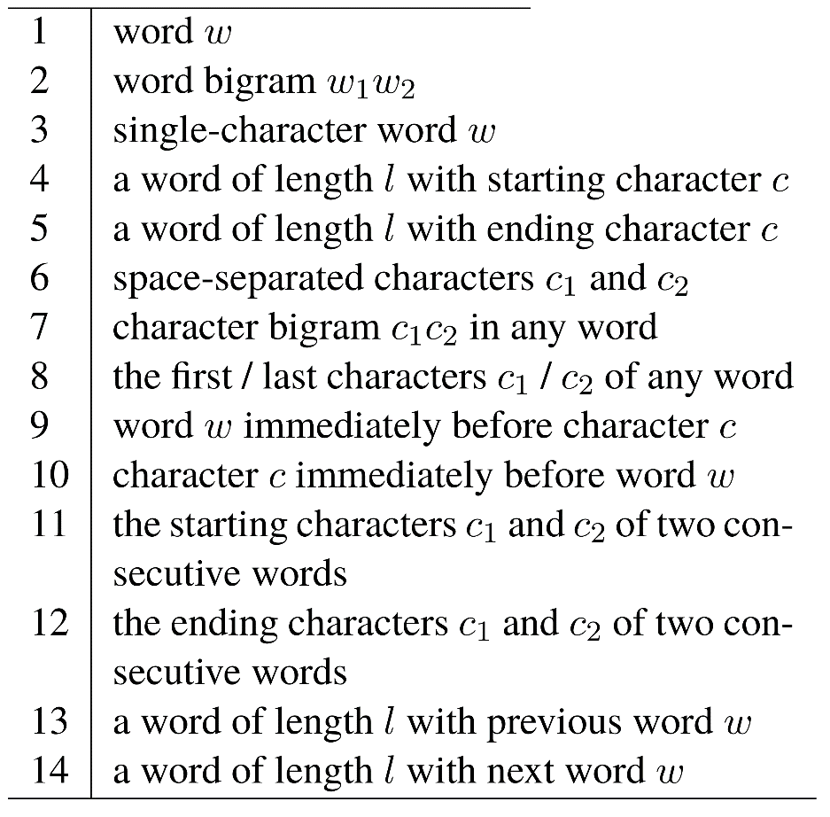
Joint Segmentation and POS Tagging
Feature templates for the baseline segmentor
Zhang, Yue, and Stephen Clark. "Joint Word Segmentation and POS Tagging Using a Single Perceptron." ACL. 2008.

Slide 57
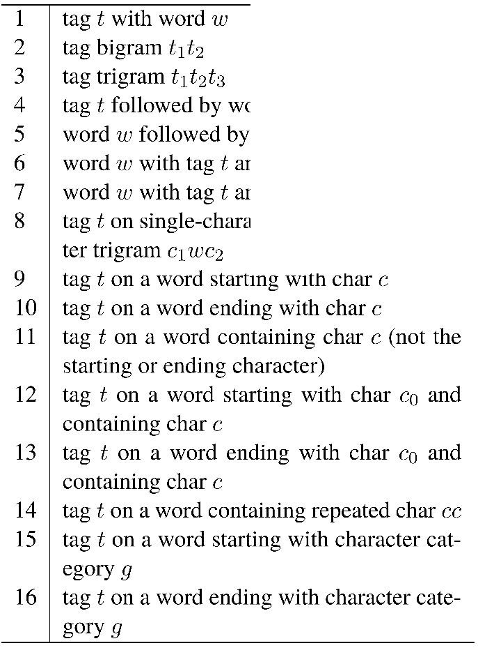
Joint Segmentation and POS Tagging
Feature templates for the baseline POS tagger
Zhang, Yue, and Stephen Clark. "Joint Word Segmentation and POS Tagging Using a Single Perceptron." ACL. 2008.

Slide 58
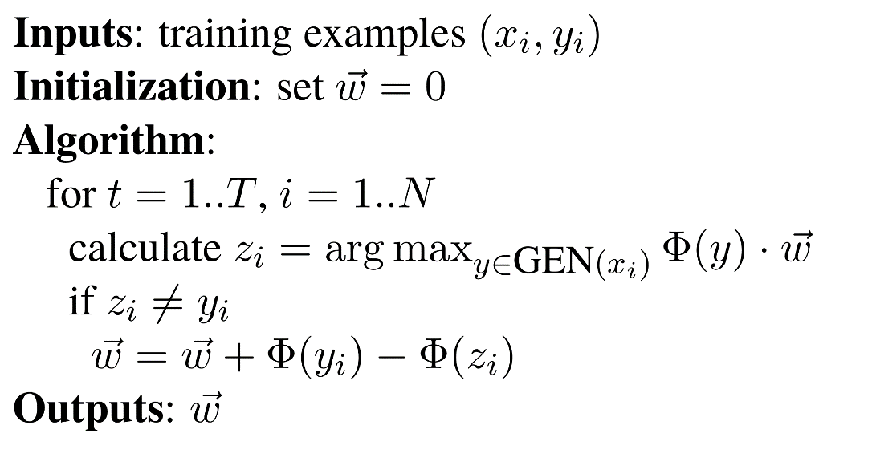
Joint Segmentation and POS Tagging
Perceptron with both segmentation and POS features
The perceptron learning algorithm
Zhang, Yue, and Stephen Clark. "Joint Word Segmentation and POS Tagging Using a Single Perceptron." ACL. 2008.

Slide 59
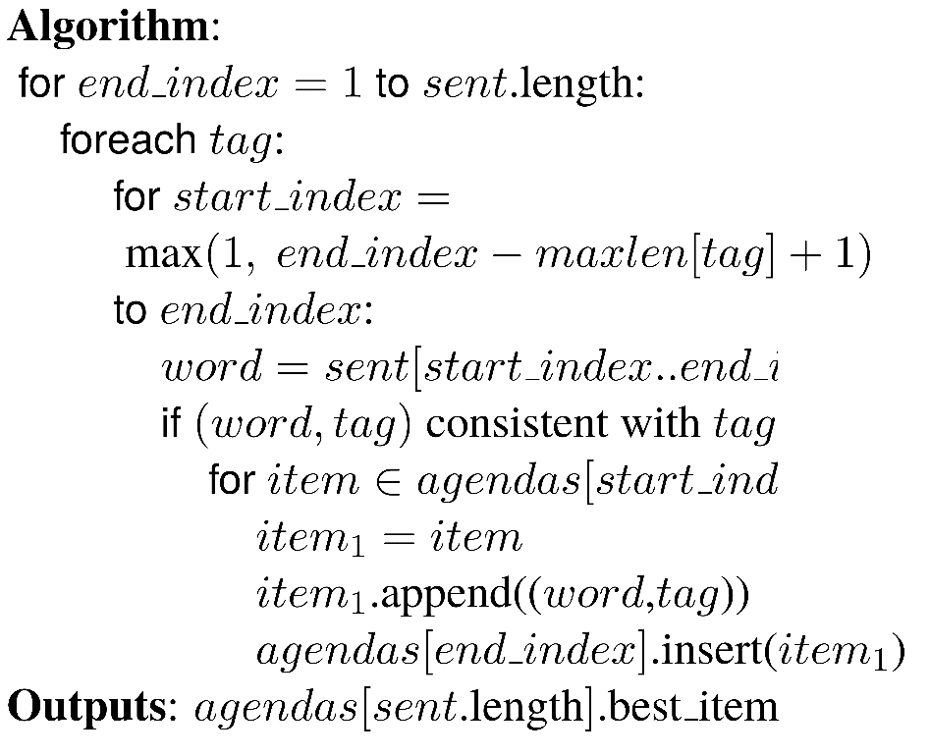
Joint Segmentation and POS Tagging
The decoding algorithm for the joint word segmentor and POS tagger, agendas[i] stores the best sequences that end at i
我
PN
我
PN
喜
VV
我
PN
喜欢
VN
我
PN
喜欢
VV
读书
NN
我
PN
喜
NN
喜
NN
我
PN
欢VV
……
我喜
VV
我喜欢
VV
Zhang, Yue, and Stephen Clark. "Joint Word Segmentation and POS Tagging Using a Single Perceptron." ACL. 2008.

Slide 60
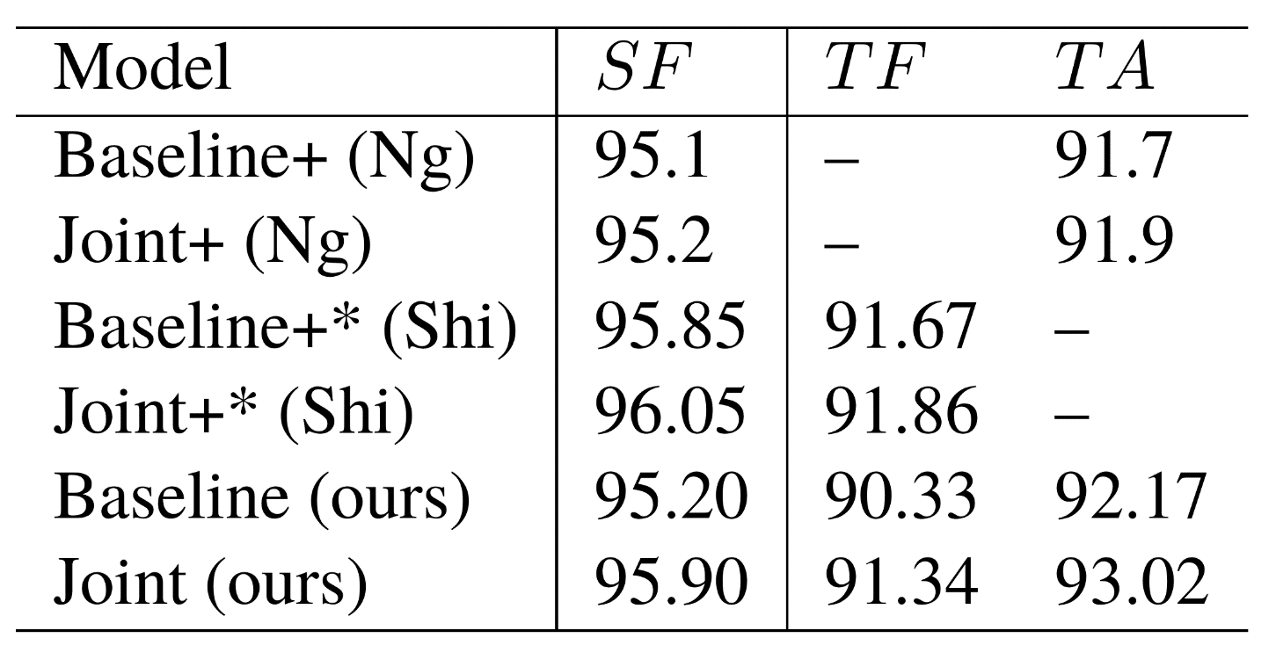
Joint Segmentation and POS Tagging
Results by 10-fold cross validation using CTB
Zhang, Yue, and Stephen Clark. "Joint Word Segmentation and POS Tagging Using a Single Perceptron." ACL. 2008.

Slide 61
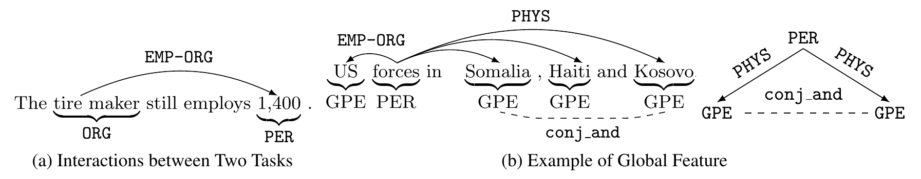
Joint Entity Relation Extraction
Task
Li, Qi, and Heng Ji. "Incremental Joint Extraction of Entity Mentions and Relations." ACL (1). 2014.

Slide 62
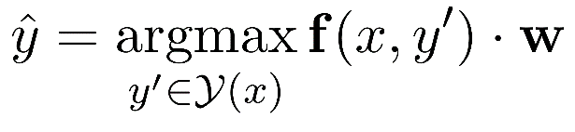
Joint Entity Relation Extraction
A Single Model
Li, Qi, and Heng Ji. "Incremental Joint Extraction of Entity Mentions and Relations." ACL (1). 2014.

Slide 63
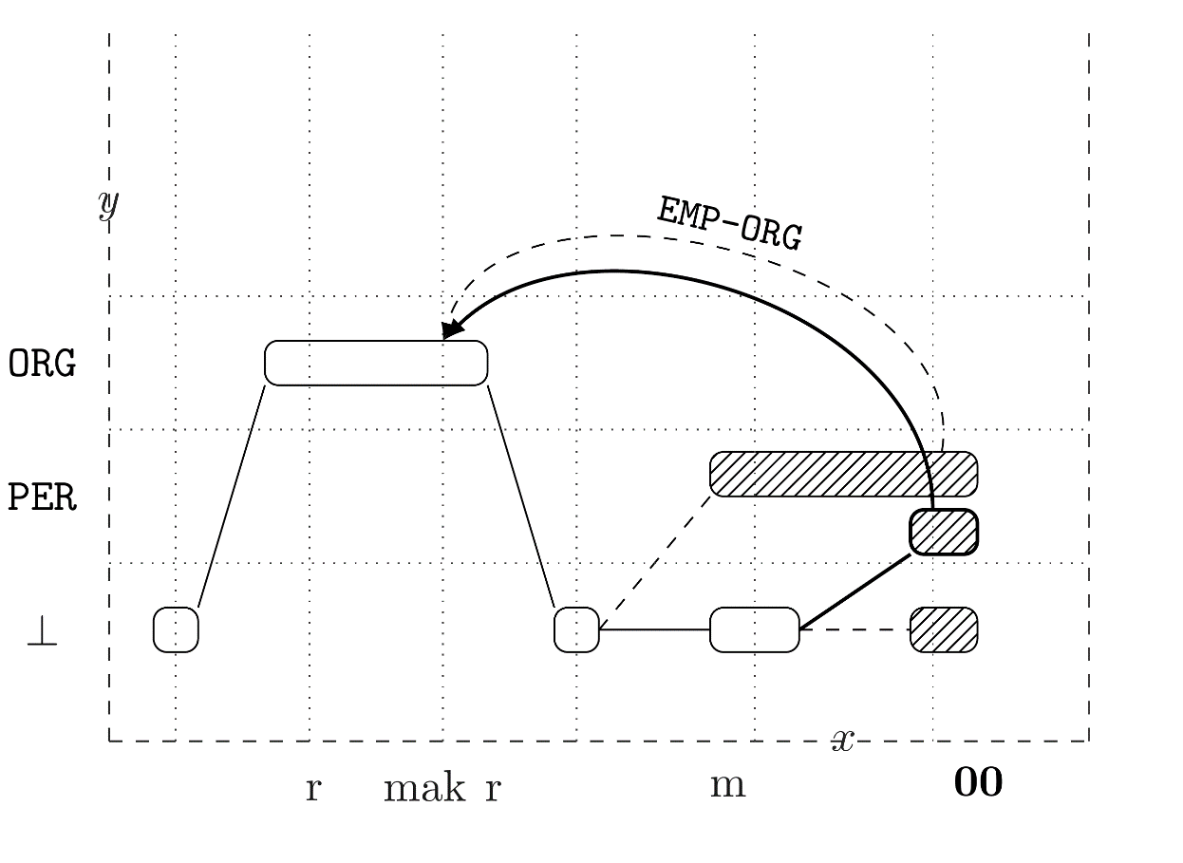
Joint Entity Relation Extraction
Beam Search
Li, Qi, and Heng Ji. "Incremental Joint Extraction of Entity Mentions and Relations." ACL (1). 2014.

Slide 64
Joint Entity Relation Extraction
Feature
Local features
Gazetteer features
Case features
Contextual features
Parsing-based features
Global entity mention features
Coreference consistency
Neighbor coherence
Part-of-whole consistency
Global relation features
Role coherence
Triangle constraint
Inter-dependent compatibility
Neighbor coherence
Li, Qi, and Heng Ji. "Incremental Joint Extraction of Entity Mentions and Relations." ACL (1). 2014.

Slide 65
Joint Entity Relation Extraction
Experiments
Data:
Training data: ACE’05
Validation data: ACE’04
Li, Qi, and Heng Ji. "Incremental Joint Extraction of Entity Mentions and Relations." ACL (1). 2014.

Slide 66
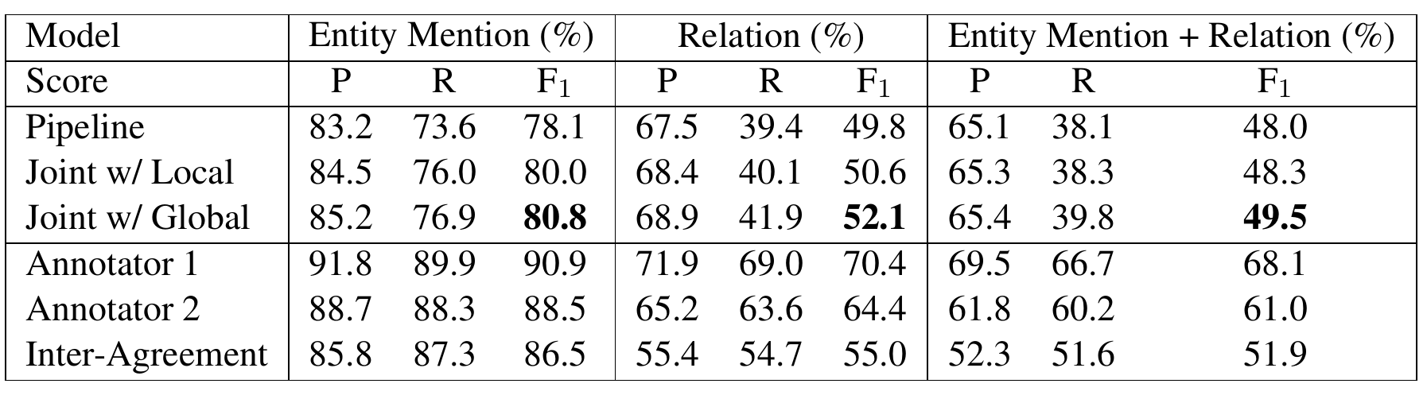
Joint Entity Relation Extraction
Results on ACE
Li, Qi, and Heng Ji. "Incremental Joint Extraction of Entity Mentions and Relations." ACL (1). 2014.

Slide 67
Statistical Models
Graph-Based Methods
Transition-Based Methods

Slide 68
A Transition System
Automata
State
Start state —— an empty structure
End state —— the output structure
Intermediate states —— partially constructed structures
Actions
Change one state to another
Yue Zhang and Stephen Clark. 2011. Syntactic Processing Using the Generalized Perceptron and Beam Search. In Computational Linguistics, 37(1), March.

Slide 69
A Transition System
Automata
start
Yue Zhang and Stephen Clark. 2011. Syntactic Processing Using the Generalized Perceptron and Beam Search. In Computational Linguistics, 37(1), March.

Slide 70
A Transition System
Automata
a₀
start
S₁
Yue Zhang and Stephen Clark. 2011. Syntactic Processing Using the Generalized Perceptron and Beam Search. In Computational Linguistics, 37(1), March.

Slide 71
A Transition System
Automata
a₀
a₁
start
S₁
…
Yue Zhang and Stephen Clark. 2011. Syntactic Processing Using the Generalized Perceptron and Beam Search. In Computational Linguistics, 37(1), March.

Slide 72
A Transition System
Automata
a₀
a₁
a_{i-1}
start
S₁
S_{i}
…
Yue Zhang and Stephen Clark. 2011. Syntactic Processing Using the Generalized Perceptron and Beam Search. In Computational Linguistics, 37(1), March.

Slide 73
A Transition System
Automata
a₀
a₁
a_{i-1}
a_{i}
start
S₁
S_{i}
…
…
Yue Zhang and Stephen Clark. 2011. Syntactic Processing Using the Generalized Perceptron and Beam Search. In Computational Linguistics, 37(1), March.

Slide 74
A Transition System
Automata
a₀
a₁
a_{i-1}
a_{i}
a_{n-1}
start
S₁
S_{i}
S_{n}
…
…
Yue Zhang and Stephen Clark. 2011. Syntactic Processing Using the Generalized Perceptron and Beam Search. In Computational Linguistics, 37(1), March.

Slide 75
A Transition System
Automata
a₀
a₁
a_{i-1}
a_{i}
a_{n-1}
a_{n}
start
S₁
S_{i}
S_{n}
end
…
…
Yue Zhang and Stephen Clark. 2011. Syntactic Processing Using the Generalized Perceptron and Beam Search. In Computational Linguistics, 37(1), March.

Slide 76
A Transition System
State
Corresponds to partial results during decoding
start state, end state, S_{i}
Actions
The operations that can be applied for state transition
Construct output incrementally
a_{i}
a₀
a₁
a_{i-1}
a_{i}
a_{n-1}
a_{n}
start
S₁
S_{i}
S_{n}
end
…
…
Yue Zhang and Stephen Clark. 2011. Syntactic Processing Using the Generalized Perceptron and Beam Search. In Computational Linguistics, 37(1), March.

Slide 77
Transition-based Dependency Parsing
An Example
S-SHIFT
R-REDUCE
AL-ARC-LEFT
AR-ARC-RIGHT
He does it here
Yue Zhang and Stephen Clark. 2011. Syntactic Processing Using the Generalized Perceptron and Beam Search. In Computational Linguistics, 37(1), March.

Slide 78
Transition-based Dependency Parsing
An Example
S-SHIFT
R-REDUCE
AL-ARC-LEFT
AR-ARC-RIGHT
He does it here
S
He
does it here
Yue Zhang and Stephen Clark. 2011. Syntactic Processing Using the Generalized Perceptron and Beam Search. In Computational Linguistics, 37(1), March.

Slide 79
Transition-based Dependency Parsing
An Example
S-SHIFT
R-REDUCE
AL-ARC-LEFT
AR-ARC-RIGHT
He does it here
S
He
AL
does it here
does it here
He
Yue Zhang and Stephen Clark. 2011. Syntactic Processing Using the Generalized Perceptron and Beam Search. In Computational Linguistics, 37(1), March.

Slide 80
Transition-based Dependency Parsing
An Example
S-SHIFT
R-REDUCE
AL-ARC-LEFT
AR-ARC-RIGHT
He does it here
S
He
AL
S
does it here
does it here
does
it here
He
He
Yue Zhang and Stephen Clark. 2011. Syntactic Processing Using the Generalized Perceptron and Beam Search. In Computational Linguistics, 37(1), March.

Slide 81
Transition-based Dependency Parsing
AR
An Example
S-SHIFT
R-REDUCE
AL-ARC-LEFT
AR-ARC-RIGHT
He does it here
S
He
AL
S
does it here
does it here
does
it here
He
He
does it
here
He
Yue Zhang and Stephen Clark. 2011. Syntactic Processing Using the Generalized Perceptron and Beam Search. In Computational Linguistics, 37(1), March.

Slide 82
Transition-based Dependency Parsing
AR
An Example
S-SHIFT
R-REDUCE
AL-ARC-LEFT
AR-ARC-RIGHT
He does it here
S
He
AL
S
does it here
does it here
it here
does
He
He
does
here
does it
R
here
He
it
He
Yue Zhang and Stephen Clark. 2011. Syntactic Processing Using the Generalized Perceptron and Beam Search. In Computational Linguistics, 37(1), March.

Slide 83
Transition-based Dependency Parsing
AR
An Example
S-SHIFT
R-REDUCE
AL-ARC-LEFT
AR-ARC-RIGHT
He does it here
S
He
AL
S
does it here
does it here
does
it here
He
He
does here
does
here
does it
AR
R
here
He
it
He
it
He
Yue Zhang and Stephen Clark. 2011. Syntactic Processing Using the Generalized Perceptron and Beam Search. In Computational Linguistics, 37(1), March.

Slide 84
Transition-based Dependency Parsing
AR
An Example
S-SHIFT
R-REDUCE
AL-ARC-LEFT
AR-ARC-RIGHT
He does it here
S
He
AL
S
does it here
does it here
does
it here
He
He
does
does here
does
here
does it
R
AR
R
here
He
it
here
He
it
He
it
He
Yue Zhang and Stephen Clark. 2011. Syntactic Processing Using the Generalized Perceptron and Beam Search. In Computational Linguistics, 37(1), March.

Slide 85
Search Space
Find the best sequence of actions
Exponential
S_{n}
a_{n-1}
S₂
a₂
⁞⁞⁞
S’_{n}
a’₂
a’_{n-1}
a₁
a’’₂
S₁
a’₁
S’₂
…
a’’_{n-1}
S’’_{n}
a’’₁
S’’₂
a₀
…
S₀
S’₁
•••
⁞⁞⁞
•••
a’₀
…
…
…
a’’₀
⁞
⁞
⁞
S’’₁
…
•••
•••
…
⁞⁞⁞
…
…
•••
Yue Zhang and Stephen Clark. 2011. Syntactic Processing Using the Generalized Perceptron and Beam Search. In Computational Linguistics, 37(1), March.

Slide 86
A Learning+Search Framework
start
Yue Zhang and Stephen Clark. 2011. Syntactic Processing Using the Generalized Perceptron and Beam Search. In Computational Linguistics, 37(1), March.

Slide 87
A Learning+Search Framework
agenda
S₁₁
S₁₂
S₁₃
start
…
S_{1k}
…
Yue Zhang and Stephen Clark. 2011. Syntactic Processing Using the Generalized Perceptron and Beam Search. In Computational Linguistics, 37(1), March.

Slide 88
A Learning+Search Framework
agenda
S₁₁
…
S₁₂
…
S₁₃
…
start
…
…
S_{1k}
…
…
…
…
…
Yue Zhang and Stephen Clark. 2011. Syntactic Processing Using the Generalized Perceptron and Beam Search. In Computational Linguistics, 37(1), March.

Slide 89
A Learning+Search Framework
agenda
S₁₁
…
S_{i1}
S₁₂
…
S_{i2}
S₁₃
…
S_{i3}
start
…
…
…
S_{1k}
…
S_{ik}
…
…
…
…
…
…
…
Yue Zhang and Stephen Clark. 2011. Syntactic Processing Using the Generalized Perceptron and Beam Search. In Computational Linguistics, 37(1), March.

Slide 90
A Learning+Search Framework
agenda
S₁₁
…
S_{i1}
…
End₁
S₁₂
…
S_{i2}
…
End₂
S₁₃
…
S_{i3}
…
End₃
start
…
…
…
…
…
S_{1k}
…
S_{ik}
…
End_{K}
…
…
…
…
…
…
…
…
…
…
…
…
…
Yue Zhang and Stephen Clark. 2011. Syntactic Processing Using the Generalized Perceptron and Beam Search. In Computational Linguistics, 37(1), March.

Slide 91
A Learning+Search Framework
Dependency Parsing Example
Decoding
He does it here
Yue Zhang and Stephen Clark. 2011. Syntactic Processing Using the Generalized Perceptron and Beam Search. In Computational Linguistics, 37(1), March.

Slide 92
A Learning+Search Framework
Dependency Parsing Example
Decoding
He does it here
S
He
does it here
Yue Zhang and Stephen Clark. 2011. Syntactic Processing Using the Generalized Perceptron and Beam Search. In Computational Linguistics, 37(1), March.

Slide 93
A Learning+Search Framework
Dependency Parsing Example
Decoding
He does it here
S
He
AL
does it here
does it here
AR
He
S
He does
it here
He does
it here
Yue Zhang and Stephen Clark. 2011. Syntactic Processing Using the Generalized Perceptron and Beam Search. In Computational Linguistics, 37(1), March.

Slide 94
A Learning+Search Framework
Dependency Parsing Example
Decoding
He does it here
S
He
AL
S
does it here
does it here
it here
does
AR
He
He
S
He does
S
it here
He does it
here
AR
He does
it here
He does it
here
S
AR
Yue Zhang and Stephen Clark. 2011. Syntactic Processing Using the Generalized Perceptron and Beam Search. In Computational Linguistics, 37(1), March.

Slide 95
A Learning+Search Framework
Dependency Parsing Example
Decoding
He does it here
S
He
AL
S
does it here
does it here
it here
does
AR
He
He
S
He does
S
it here
He does it
here
AR
He does
it here
He does it
here
S
AR
does it
here
He
He does it here
here
He does
it
Yue Zhang and Stephen Clark. 2011. Syntactic Processing Using the Generalized Perceptron and Beam Search. In Computational Linguistics, 37(1), March.

Slide 96
A Learning+Search Framework
Dependency Parsing Example
Decoding
He does it here
S
He
AL
S
does it here
does it here
it here
does
AR
He
He
S
He does
S
it here
He does it
here
AR
He does
it here
He does it
here
S
AR
does it here
does it
here
He
He
He
does
here
He
it
He does it here
He
does it here
here
He does
He
it
Yue Zhang and Stephen Clark. 2011. Syntactic Processing Using the Generalized Perceptron and Beam Search. In Computational Linguistics, 37(1), March.

Slide 97
A Learning+Search Framework
Dependency Parsing Example
Decoding
He does it here
S
He
AL
S
does it here
does it here
it here
does
AR
He
He
S
He does
S
it here
He does it
here
AR
He does
it here
He does it
here
S
AR
does here
does it here
does it
here
He
it
He
He
He
does here
does
here
He
it
He does it here
He
it
He
does it here
does it here
here
He does
He
He
it
Yue Zhang and Stephen Clark. 2011. Syntactic Processing Using the Generalized Perceptron and Beam Search. In Computational Linguistics, 37(1), March.

Slide 98
A Learning+Search Framework
Dependency Parsing Example
Decoding
He does it here
S
He
AL
S
does it here
does it here
it here
does
AR
He
He
S
He does
S
it here
He does it
here
AR
He does
it here
He does it
here
S
AR
does
does here
does it here
does it
here
He
it
He
it
He
here
He
He
does here
does
here
He
it
He does it here
He
it
He
does it
does it here
does it here
here
He does
He here
He
He
it
Yue Zhang and Stephen Clark. 2011. Syntactic Processing Using the Generalized Perceptron and Beam Search. In Computational Linguistics, 37(1), March.

Slide 99
A Learning+Search Framework
Search not optional (vs graph-based structured prediction)
Learn to fix search errors
agenda
S₁₁
S₂₁
S_{i1}
S₁₂
S₂₂
S_{i2}
S₁₃
S₂₃
S_{i3}
start
…
…
…
S_{1k}
…
S_{ik}
Positive example
start
S₁₁
S₂₂
……
S_{jk+1}
…
S_{jk+1}
…
…
…
Negative
example
start
S₁₁
S₂₁
……
S_{j1}
…
…

Slide 100
A Learning+Search Framework
Advantages
Low computation complexity
Arbitrary non-local features
Learning-guided-search
Yue Zhang and Stephen Clark. 2011. Syntactic Processing Using the Generalized Perceptron and Beam Search. In Computational Linguistics, 37(1), March.

Slide 101
A Learning+Search Framework
State-of-the-art accuracies and speeds
Constituent parsing
Dependency parsing
Word Segmentation
CCG parsing
Enable joint models
Address complex search space and use joint features, which have been difficult for traditional models
Yue Zhang and Stephen Clark. 2011. Syntactic Processing Using the Generalized Perceptron and Beam Search. In Computational Linguistics, 37(1), March.

Slide 102
A Learning+Search Framework
State-of-the-art accuracies and speeds
Constituent parsing
Dependency parsing
Word Segmentation
CCG parsing
Enable joint models
Address complex search space and use joint features, which have been difficult for traditional models
Joint Search
Joint Learning
Yue Zhang and Stephen Clark. 2011. Syntactic Processing Using the Generalized Perceptron and Beam Search. In Computational Linguistics, 37(1), March.

Slide 103
A Learning+Search Framework
Global Normalization for Neural Structured Prediction
Zhou et al., (2015)
Watanabe et al., (2015)
Andor et al., (2016)
Rush et al., (2016)
Hao Zhou, Yue Zhang, Shujian Huang and Jiajun Chen. A Neural Probabilistic Structured-Prediction Model for Transition-based Dependency Parsing. In Proceedings of ACL 2015, Beijing, China, July.
Watanabe, Taro, and Eiichiro Sumita. "Transition-based neural constituent parsing." Proceedings of the 53rd Annual Meeting of the Association for Computational Linguistics and the 7th International Joint Conference on Natural Language Processing (Volume 1: Long Papers). Vol. 1. 2015.
Andor Daniel, Chris Alberti, David Weiss, Aliaksei Severyn, Alessandro Presta, Kuzman Ganchev, Slav Petrov, Michael Collins "Globally normalized transition-based neural networks." arXiv preprint arXiv:1603.06042 (2016).
Wiseman, Sam, and Alexander M. Rush. "Sequence-to-sequence learning as beam-search optimization." arXiv preprint arXiv:1606.02960 (2016).

Slide 104
Joint Segmentation and POS Tagging
The transition system
State
Partial segmented results
Unprocessed characters
Two actions
Separate (t) : t is a POS tag
Append
Yue Zhang and Stephen Clark. A Fast Decoder for Joint Word Segmentation and POS-tagging Using a Single Discriminative Model. In proceedings of EMNLP 2010. Massachusetts, USA. October.
Zhang and Clark, EMNLP 2010

Slide 105
Joint Segmentation and POS Tagging
The transition system
Initial state
我喜欢读书
我/PN 喜欢/V 读/V 书/N
[I] [like] [reading] [books]
Yue Zhang and Stephen Clark. A Fast Decoder for Joint Word Segmentation and POS-tagging Using a Single Discriminative Model. In proceedings of EMNLP 2010. Massachusetts, USA. October.

Slide 106
Joint Segmentation and POS Tagging
The transition system
Separate(PN)
我/PN
喜欢读书
我/PN 喜欢/V 读/V 书/N
[I] [like] [reading] [books]
Yue Zhang and Stephen Clark. A Fast Decoder for Joint Word Segmentation and POS-tagging Using a Single Discriminative Model. In proceedings of EMNLP 2010. Massachusetts, USA. October.

Slide 107
Joint Segmentation and POS Tagging
The transition system
Separate (V)
我/PN 喜/V
欢读书
我/PN 喜欢/V 读/V 书/N
[I] [like] [reading] [books]
Yue Zhang and Stephen Clark. A Fast Decoder for Joint Word Segmentation and POS-tagging Using a Single Discriminative Model. In proceedings of EMNLP 2010. Massachusetts, USA. October.

Slide 108
Joint Segmentation and POS Tagging
The transition system
Append
我/PN 喜欢/V
读书
我/PN 喜欢/V 读/V 书/N
[I] [like] [reading] [books]
Yue Zhang and Stephen Clark. A Fast Decoder for Joint Word Segmentation and POS-tagging Using a Single Discriminative Model. In proceedings of EMNLP 2010. Massachusetts, USA. October.

Slide 109
Joint Segmentation and POS Tagging
The transition system
Separate (V)
我/PN 喜欢/V 读/V
书
我/PN 喜欢/V 读/V 书/N
[I] [like] [reading] [books]
Yue Zhang and Stephen Clark. A Fast Decoder for Joint Word Segmentation and POS-tagging Using a Single Discriminative Model. In proceedings of EMNLP 2010. Massachusetts, USA. October.

Slide 110
Joint Segmentation and POS Tagging
The transition system
Separate (N)
我/PN 喜欢/V 读/V 书/N
我/PN 喜欢/V 读/V 书/N
[I] [like] [reading] [books]
Yue Zhang and Stephen Clark. A Fast Decoder for Joint Word Segmentation and POS-tagging Using a Single Discriminative Model. In proceedings of EMNLP 2010. Massachusetts, USA. October.

Slide 111
Joint Segmentation and POS Tagging
The transition system
End state
我/PN 喜欢/V 读/V 书/N
我/PN 喜欢/V 读/V 书/N
[I] [like] [reading] [books]
Yue Zhang and Stephen Clark. A Fast Decoder for Joint Word Segmentation and POS-tagging Using a Single Discriminative Model. In proceedings of EMNLP 2010. Massachusetts, USA. October.

Slide 112
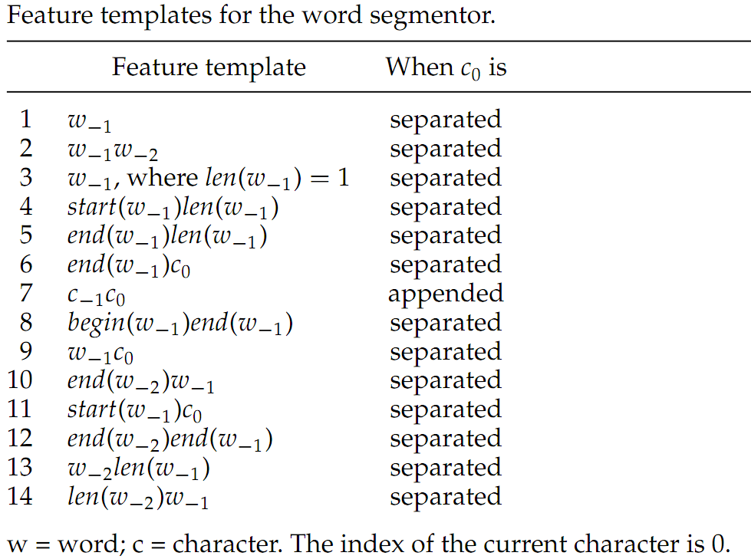
Joint Segmentation and POS Tagging
Segmentation Feature templates
Non-local
Yue Zhang and Stephen Clark. A Fast Decoder for Joint Word Segmentation and POS-tagging Using a Single Discriminative Model. In proceedings of EMNLP 2010. Massachusetts, USA. October.

Slide 113
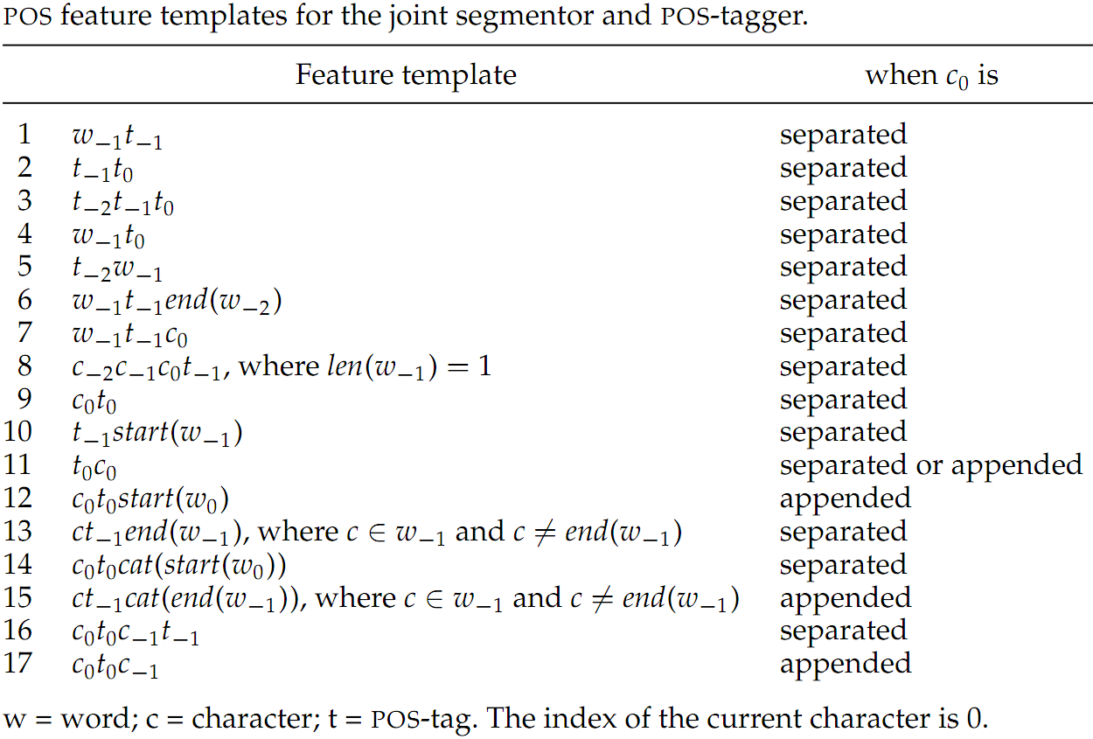
Joint Segmentation and POS Tagging
POS Feature templates
Word-level
Yue Zhang and Stephen Clark. A Fast Decoder for Joint Word Segmentation and POS-tagging Using a Single Discriminative Model. In proceedings of EMNLP 2010. Massachusetts, USA. October.

Slide 114
Joint Segmentation and POS Tagging
Experiments on CTB 5
 | SF | JF
K09 (error-driven) | 97.87 | 93.67
This work | 97.78 | 93.67
Zhang 2008 | 97.82 | 93.62
K09 (baseline) | 97.79 | 93.60
J08a | 97.85 | 93.41
J08b | 97.74 | 93.37
N07 | 97.83 | 93.32
SF = segmentation F-score; JF = joint segmentation and POS-tagging F-score
Yue Zhang and Stephen Clark. A Fast Decoder for Joint Word Segmentation and POS-tagging Using a Single Discriminative Model. In proceedings of EMNLP 2010. Massachusetts, USA. October.

Slide 115
Joint Segmentation/Tagging/Chunking
Input 他到达北京机场。 Output [NP 他/NR] [VP 到达/VV] [NP 北京/NR 机场/NN] [O 。/PU]
[He] [arrived] [Beijing airport] [.]
Chunking knowledge can potentially improve segmentation/tagging.
Chunk cluster features to avoid sparsity.
Chen Lyu, Yue Zhang and Donghong Ji. Joint Word Segmentation, POS-Tagging and Syntactic Chunking. In Proceedings of the AAAI 2016, Phoenix, Arizona, USA, February.

Slide 116
Joint Segmentation/Tagging/Chunking
Character-based chunking
Action: initial state
chunk buffer
word buffer
character buffer
他 到 达 北 京 机 场 。
[NP 他/NR] [VP 到达/VV] [NP 北京/NR 机场/NN] [O 。/PU]
[He] [arrived] [Beijing airport] [.]
Chen Lyu, Yue Zhang and Donghong Ji. Joint Word Segmentation, POS-Tagging and Syntactic Chunking. In Proceedings of the AAAI 2016, Phoenix, Arizona, USA, February.

Slide 117
Joint Segmentation/Tagging/Chunking
Character-based chunking
Action: SEP(NR)
chunk buffer
word buffer
character buffer
[他/NR
到 达 北 京 机 场 。
[NP 他/NR] [VP 到达/VV] [NP 北京/NR 机场/NN] [O 。/PU]
[He] [arrived] [Beijing airport] [.]
Chen Lyu, Yue Zhang and Donghong Ji. Joint Word Segmentation, POS-Tagging and Syntactic Chunking. In Proceedings of the AAAI 2016, Phoenix, Arizona, USA, February.

Slide 118
Joint Segmentation/Tagging/Chunking
Character-based chunking
Action: FIN W
chunk buffer
word buffer
character buffer
[他/NR]
到 达 北 京 机 场 。
[NP 他/NR] [VP 到达/VV] [NP 北京/NR 机场/NN] [O 。/PU]
[He] [arrived] [Beijing airport] [.]
Chen Lyu, Yue Zhang and Donghong Ji. Joint Word Segmentation, POS-Tagging and Syntactic Chunking. In Proceedings of the AAAI 2016, Phoenix, Arizona, USA, February.

Slide 119
Joint Segmentation/Tagging/Chunking
Character-based chunking
Action: SEP(NP)
chunk buffer
word buffer
character buffer
[NP 他/NR]
到 达 北 京 机 场 。
[NP 他/NR] [VP 到达/VV] [NP 北京/NR 机场/NN] [O 。/PU]
[He] [arrived] [Beijing airport] [.]
Chen Lyu, Yue Zhang and Donghong Ji. Joint Word Segmentation, POS-Tagging and Syntactic Chunking. In Proceedings of the AAAI 2016, Phoenix, Arizona, USA, February.

Slide 120
Joint Segmentation/Tagging/Chunking
Character-based chunking
Action: SEP(VV)
chunk buffer
word buffer
character buffer
[NP 他/NR]
[到/VV
达 北 京 机 场 。
[NP 他/NR] [VP 到达/VV] [NP 北京/NR 机场/NN] [O 。/PU]
[He] [arrived] [Beijing airport] [.]
Chen Lyu, Yue Zhang and Donghong Ji. Joint Word Segmentation, POS-Tagging and Syntactic Chunking. In Proceedings of the AAAI 2016, Phoenix, Arizona, USA, February.

Slide 121
Joint Segmentation/Tagging/Chunking
Character-based chunking
Action: APP W
chunk buffer
word buffer
character buffer
[NP 他/NR]
[到达/VV
北 京 机 场 。
[NP 他/NR] [VP 到达/VV] [NP 北京/NR 机场/NN] [O 。/PU]
[He] [arrived] [Beijing airport] [.]
Chen Lyu, Yue Zhang and Donghong Ji. Joint Word Segmentation, POS-Tagging and Syntactic Chunking. In Proceedings of the AAAI 2016, Phoenix, Arizona, USA, February.

Slide 122
Joint Segmentation/Tagging/Chunking
Character-based chunking
Action: FIN W
chunk buffer
word buffer
character buffer
[NP 他/NR]
[到达/VV]
北 京 机 场 。
[NP 他/NR] [VP 到达/VV] [NP 北京/NR 机场/NN] [O 。/PU]
[He] [arrived] [Beijing airport] [.]
Chen Lyu, Yue Zhang and Donghong Ji. Joint Word Segmentation, POS-Tagging and Syntactic Chunking. In Proceedings of the AAAI 2016, Phoenix, Arizona, USA, February.

Slide 123
Joint Segmentation/Tagging/Chunking
Character-based chunking
Action: SEP(VP)
chunk buffer
word buffer
character buffer
[NP 他/NR]
[VP 到达/VV]
北 京 机 场 。
[NP 他/NR] [VP 到达/VV] [NP 北京/NR 机场/NN] [O 。/PU]
[He] [arrived] [Beijing airport] [.]
Chen Lyu, Yue Zhang and Donghong Ji. Joint Word Segmentation, POS-Tagging and Syntactic Chunking. In Proceedings of the AAAI 2016, Phoenix, Arizona, USA, February.

Slide 124
Joint Segmentation/Tagging/Chunking
Character-based chunking
Action: SEP(NR)
chunk buffer
word buffer
character buffer
[NP 他/NR]
[VP 到达/VV]
[北/NR
京 机 场 。
[NP 他/NR] [VP 到达/VV] [NP 北京/NR 机场/NN] [O 。/PU]
[He] [arrived] [Beijing airport] [.]
Chen Lyu, Yue Zhang and Donghong Ji. Joint Word Segmentation, POS-Tagging and Syntactic Chunking. In Proceedings of the AAAI 2016, Phoenix, Arizona, USA, February.

Slide 125
Joint Segmentation/Tagging/Chunking
Character-based chunking
Action: APP W
chunk buffer
word buffer
character buffer
[NP 他/NR]
[VP 到达/VV]
[北京/NR
机 场 。
[NP 他/NR] [VP 到达/VV] [NP 北京/NR 机场/NN] [O 。/PU]
[He] [arrived] [Beijing airport] [.]
Chen Lyu, Yue Zhang and Donghong Ji. Joint Word Segmentation, POS-Tagging and Syntactic Chunking. In Proceedings of the AAAI 2016, Phoenix, Arizona, USA, February.

Slide 126
Joint Segmentation/Tagging/Chunking
Character-based chunking
Action: FIN W
chunk buffer
word buffer
character buffer
[NP 他/NR]
[VP 到达/VV]
[北京/NR]
机 场 。
[NP 他/NR] [VP 到达/VV] [NP 北京/NR 机场/NN] [O 。/PU]
[He] [arrived] [Beijing airport] [.]
Chen Lyu, Yue Zhang and Donghong Ji. Joint Word Segmentation, POS-Tagging and Syntactic Chunking. In Proceedings of the AAAI 2016, Phoenix, Arizona, USA, February.

Slide 127
Joint Segmentation/Tagging/Chunking
Character-based chunking
Action: SEP(NP)
chunk buffer
word buffer
character buffer
[NP 他/NR]
[VP 到达/VV]
[NP 北京/NR]
机 场 。
[NP 他/NR] [VP 到达/VV] [NP 北京/NR 机场/NN] [O 。/PU]
[He] [arrived] [Beijing airport] [.]
Chen Lyu, Yue Zhang and Donghong Ji. Joint Word Segmentation, POS-Tagging and Syntactic Chunking. In Proceedings of the AAAI 2016, Phoenix, Arizona, USA, February.

Slide 128
Joint Segmentation/Tagging/Chunking
Character-based chunking
Action: SEP(NN)
chunk buffer
word buffer
character buffer
[NP 他/NR]
[VP 到达/VV]
[NP 北京/NR]
[机/NN
场 。
[NP 他/NR] [VP 到达/VV] [NP 北京/NR 机场/NN] [O 。/PU]
[He] [arrived] [Beijing airport] [.]
Chen Lyu, Yue Zhang and Donghong Ji. Joint Word Segmentation, POS-Tagging and Syntactic Chunking. In Proceedings of the AAAI 2016, Phoenix, Arizona, USA, February.

Slide 129
Joint Segmentation/Tagging/Chunking
Character-based chunking
Action: APP W
chunk buffer
word buffer
character buffer
[NP 他/NR]
[VP 到达/VV]
[NP 北京/NR]
[机场/NN
。
[NP 他/NR] [VP 到达/VV] [NP 北京/NR 机场/NN] [O 。/PU]
[He] [arrived] [Beijing airport] [.]
Chen Lyu, Yue Zhang and Donghong Ji. Joint Word Segmentation, POS-Tagging and Syntactic Chunking. In Proceedings of the AAAI 2016, Phoenix, Arizona, USA, February.

Slide 130
Joint Segmentation/Tagging/Chunking
Character-based chunking
Action: FIN W
chunk buffer
word buffer
character buffer
[NP 他/NR]
[VP 到达/VV]
[NP 北京/NR]
[机场/NN]
。
[NP 他/NR] [VP 到达/VV] [NP 北京/NR 机场/NN] [O 。/PU]
[He] [arrived] [Beijing airport] [.]
Chen Lyu, Yue Zhang and Donghong Ji. Joint Word Segmentation, POS-Tagging and Syntactic Chunking. In Proceedings of the AAAI 2016, Phoenix, Arizona, USA, February.

Slide 131
Joint Segmentation/Tagging/Chunking
Character-based chunking
Action: APP C
chunk buffer
word buffer
character buffer
[NP 他/NR]
[VP 到达/VV]
[NP 北京/NR 机场/NN]
。
[NP 他/NR] [VP 到达/VV] [NP 北京/NR 机场/NN] [O 。/PU]
[He] [arrived] [Beijing airport] [.]
Chen Lyu, Yue Zhang and Donghong Ji. Joint Word Segmentation, POS-Tagging and Syntactic Chunking. In Proceedings of the AAAI 2016, Phoenix, Arizona, USA, February.

Slide 132
Joint Segmentation/Tagging/Chunking
Character-based chunking
Action: SEP(PU)
chunk buffer
word buffer
character buffer
[NP 他/NR]
[VP 到达/VV]
[NP 北京/NR 机场/NN]
[。/PU
[NP 他/NR] [VP 到达/VV] [NP 北京/NR 机场/NN] [O 。/PU]
[He] [arrived] [Beijing airport] [.]
Chen Lyu, Yue Zhang and Donghong Ji. Joint Word Segmentation, POS-Tagging and Syntactic Chunking. In Proceedings of the AAAI 2016, Phoenix, Arizona, USA, February.

Slide 133
Joint Segmentation/Tagging/Chunking
Character-based chunking
Action: FIN W
chunk buffer
word buffer
character buffer
[NP 他/NR]
[VP 到达/VV]
[NP 北京/NR 机场/NN]
[。/PU]
[NP 他/NR] [VP 到达/VV] [NP 北京/NR 机场/NN] [O 。/PU]
[He] [arrived] [Beijing airport] [.]
Chen Lyu, Yue Zhang and Donghong Ji. Joint Word Segmentation, POS-Tagging and Syntactic Chunking. In Proceedings of the AAAI 2016, Phoenix, Arizona, USA, February.

Slide 134
Joint Segmentation/Tagging/Chunking
Character-based chunking
Action: SEP(O)
chunk buffer
word buffer
character buffer
[NP 他/NR]
[VP 到达/VV]
[NP 北京/NR 机场/NN]
[O 。/PU]
[NP 他/NR] [VP 到达/VV] [NP 北京/NR 机场/NN] [O 。/PU]
[He] [arrived] [Beijing airport] [.]
Chen Lyu, Yue Zhang and Donghong Ji. Joint Word Segmentation, POS-Tagging and Syntactic Chunking. In Proceedings of the AAAI 2016, Phoenix, Arizona, USA, February.

Slide 135
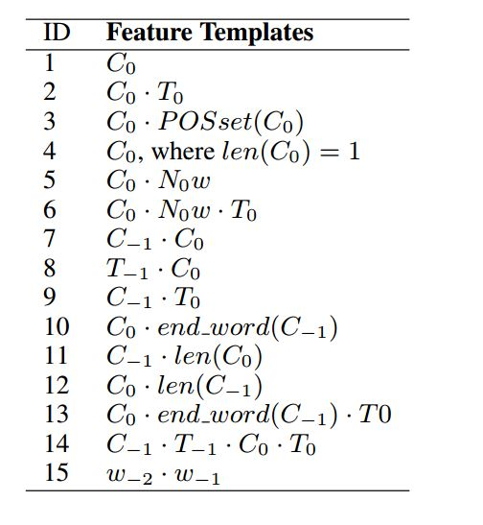
Joint Segmentation/Tagging/Chunking
Character-based chunking feature template
Chen Lyu, Yue Zhang and Donghong Ji. Joint Word Segmentation, POS-Tagging and Syntactic Chunking. In Proceedings of the AAAI 2016, Phoenix, Arizona, USA, February.

Slide 136
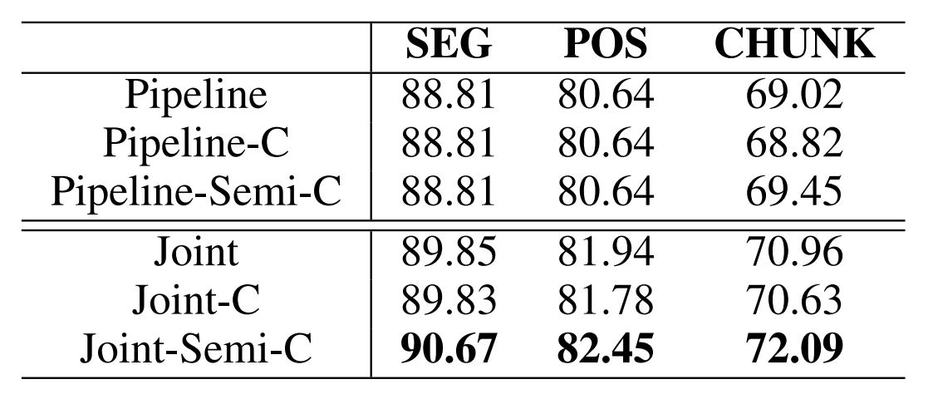
Joint Segmentation/Tagging/Chunking
Results on CTB
Chen Lyu, Yue Zhang and Donghong Ji. Joint Word Segmentation, POS-Tagging and Syntactic Chunking. In Proceedings of the AAAI 2016, Phoenix, Arizona, USA, February.

Slide 137
Joint Segmentation, Tagging and Normalization
Text normalization is introduced as a pre-processing step for microblog processing, which transforms informal words into their standard forms. For example, “tmrw” has been frequently used in tweets for is for “tomorrow”.
Task
pear
work stress big
工作鸭梨大啊！
工作/NN 压力/NN 大/VA 啊/SP !/PU
Tao Qian, Yue Zhang, Meishan Zhang and Donghong Ji. A Transition-based Model for Joint Segmentation, POS-tagging and Normalization. In proceedings of EMNLP 2015, Lisboa, Portugal, September.

Slide 138
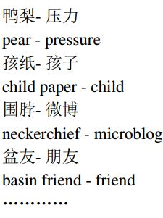
Joint Segmentation, Tagging and Normalization
Normalization dictionary
Tao Qian, Yue Zhang, Meishan Zhang and Donghong Ji. A Transition-based Model for Joint Segmentation, POS-tagging and Normalization. In proceedings of EMNLP 2015, Lisboa, Portugal, September.

Slide 139
Joint Segmentation, Tagging and Normalization
Transition actions for joint segmentation, tagging and normalization
Actions: initial state
word buffer
character buffer
工 作 鸭 梨 大 啊 ！
工作/NN 压力/NN 大/VA 啊/SP !/PU
Work stress big ah !
Tao Qian, Yue Zhang, Meishan Zhang and Donghong Ji. A Transition-based Model for Joint Segmentation, POS-tagging and Normalization. In proceedings of EMNLP 2015, Lisboa, Portugal, September.

Slide 140
Joint Segmentation, Tagging and Normalization
Transition actions for joint segmentation, tagging and normalization
Actions: SEP(工, NN)
word buffer
character buffer
工/NN
作 鸭 梨 大 啊 ！
工作/NN 压力/NN 大/VA 啊/SP !/PU
Work stress big ah !
Tao Qian, Yue Zhang, Meishan Zhang and Donghong Ji. A Transition-based Model for Joint Segmentation, POS-tagging and Normalization. In proceedings of EMNLP 2015, Lisboa, Portugal, September.

Slide 141
Joint Segmentation, Tagging and Normalization
Transition actions for joint segmentation, tagging and normalization
Actions: APP(作)
word buffer
character buffer
工作/NN
鸭 梨 大 啊 ！
工作/NN 压力/NN 大/VA 啊/SP !/PU
Work stress big ah !
Tao Qian, Yue Zhang, Meishan Zhang and Donghong Ji. A Transition-based Model for Joint Segmentation, POS-tagging and Normalization. In proceedings of EMNLP 2015, Lisboa, Portugal, September.

Slide 142
Joint Segmentation, Tagging and Normalization
Transition actions for joint segmentation, tagging and normalization
Actions: SEP(鸭, NN)
word buffer
character buffer
工作/NN 鸭/NN
梨 大 啊 ！
工作/NN 压力/NN 大/VA 啊/SP !/PU
Work stress big ah !
Tao Qian, Yue Zhang, Meishan Zhang and Donghong Ji. A Transition-based Model for Joint Segmentation, POS-tagging and Normalization. In proceedings of EMNLP 2015, Lisboa, Portugal, September.

Slide 143
Joint Segmentation, Tagging and Normalization
Transition actions for joint segmentation, tagging and normalization
Actions: APP(梨)
word buffer
character buffer
工作/NN 鸭梨/NN
大 啊 ！
工作/NN 压力/NN 大/VA 啊/SP !/PU
Work stress big ah !
Tao Qian, Yue Zhang, Meishan Zhang and Donghong Ji. A Transition-based Model for Joint Segmentation, POS-tagging and Normalization. In proceedings of EMNLP 2015, Lisboa, Portugal, September.

Slide 144
Joint Segmentation, Tagging and Normalization
Transition actions for joint segmentation, tagging and normalization
Actions: SEPS(大, VA, 压力)
word buffer
character buffer
工作/NN 压力/NN 大/VA
啊 ！
鸭梨/NN
工作/NN 压力/NN 大/VA 啊/SP !/PU
Work stress big ah !
Tao Qian, Yue Zhang, Meishan Zhang and Donghong Ji. A Transition-based Model for Joint Segmentation, POS-tagging and Normalization. In proceedings of EMNLP 2015, Lisboa, Portugal, September.

Slide 145
Joint Segmentation, Tagging and Normalization
Transition actions for joint segmentation, tagging and normalization
Actions: SEP(啊, SP)
word buffer
character buffer
工作/NN 压力/NN 大/VA 啊/SP
！
工作/NN 压力/NN 大/VA 啊/SP !/PU
Work stress big ah !
Tao Qian, Yue Zhang, Meishan Zhang and Donghong Ji. A Transition-based Model for Joint Segmentation, POS-tagging and Normalization. In proceedings of EMNLP 2015, Lisboa, Portugal, September.

Slide 146
Joint Segmentation, Tagging and Normalization
Transition actions for joint segmentation, tagging and normalization
Actions: SEP(！, PU)
word buffer
character buffer
工作/NN 压力/NN 大/VA 啊/SP ！/PU
工作/NN 压力/NN 大/VA 啊/SP !/PU
Work stress big ah !
Tao Qian, Yue Zhang, Meishan Zhang and Donghong Ji. A Transition-based Model for Joint Segmentation, POS-tagging and Normalization. In proceedings of EMNLP 2015, Lisboa, Portugal, September.

Slide 147
Joint Segmentation, Tagging and Normalization
Features
The segmentation feature templates of Zhang and Clark (2011)
Extracting language model features by using word-based language model learned from a large quantity of standard texts
Tao Qian, Yue Zhang, Meishan Zhang and Donghong Ji. A Transition-based Model for Joint Segmentation, POS-tagging and Normalization. In proceedings of EMNLP 2015, Lisboa, Portugal, September.

Slide 148
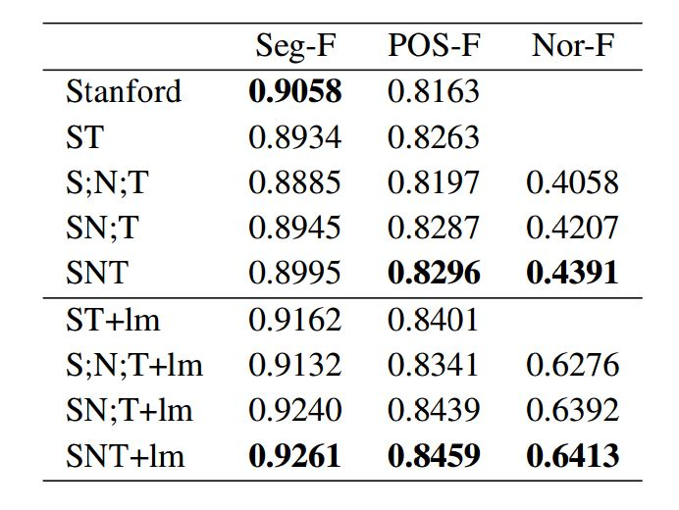
Joint Segmentation, Tagging and Normalization
Results on CTB
Tao Qian, Yue Zhang, Meishan Zhang and Donghong Ji. A Transition-based Model for Joint Segmentation, POS-tagging and Normalization. In proceedings of EMNLP 2015, Lisboa, Portugal, September.

Slide 149
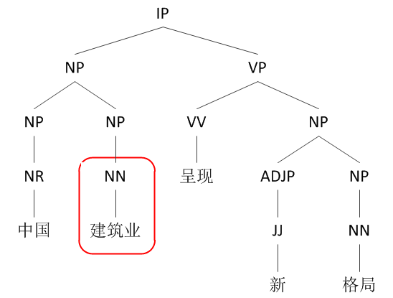
Joint Segmentation, POS-tagging and Constituent Parsing
Traditional: word-based Chinese parsing
CTB-style word-based syntax tree for “中国 (China) 建筑业 (architecture industry) 呈现 (show) 新 (new) 格局 (pattern)”.
Meishan Zhang, Yue Zhang, Wanxiang Che and Ting Liu. Chinese Parsing Exploiting Characters. In proceedings of ACL 2013. Sophia, Bulgaria. August.

Slide 150
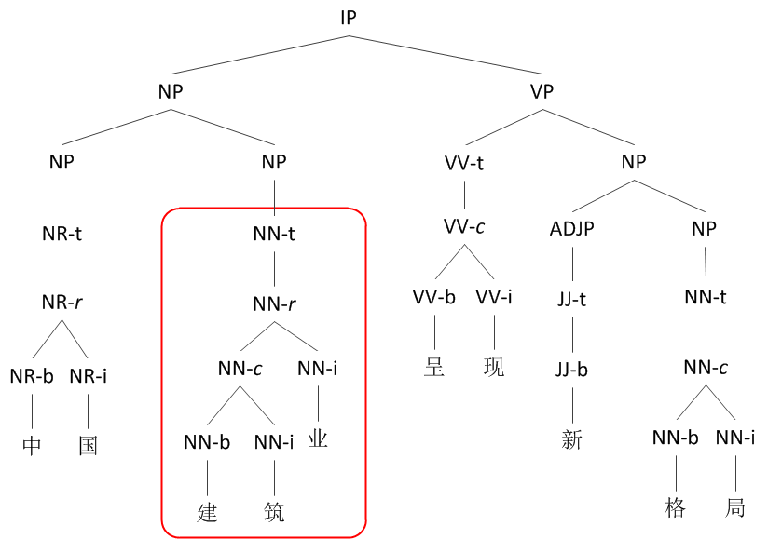
Joint Segmentation, POS-tagging and Constituent Parsing
This: character-based Chinese parsing
Character-level syntax tree with hierarchal word structures for “中 (middle) 国 (nation) 建 (construction) 筑 (building) 业 (industry) 呈 (present) 现 (show) 新 (new) 格 (style) 局 (situation)”.
Meishan Zhang, Yue Zhang, Wanxiang Che and Ting Liu. Chinese Parsing Exploiting Characters. In proceedings of ACL 2013. Sophia, Bulgaria. August.

Slide 151
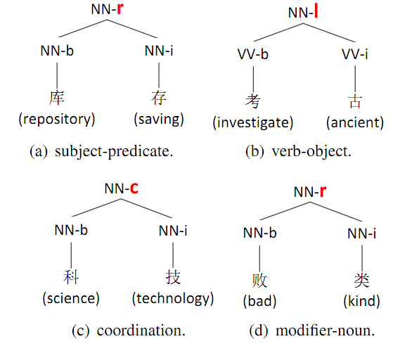
Joint Segmentation, POS-tagging and Constituent Parsing
Why character-based?
Chinese words have syntactic structures.
库存：stock
考古：archaeology
科技：Science and technology
败类：scum
Meishan Zhang, Yue Zhang, Wanxiang Che and Ting Liu. Chinese Parsing Exploiting Characters. In proceedings of ACL 2013. Sophia, Bulgaria. August.

Slide 152
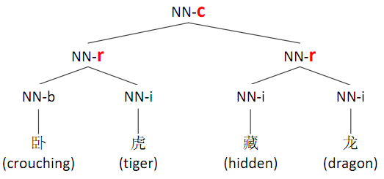
Joint Segmentation, POS-tagging and Constituent Parsing
Why character-based?
Chinese words have syntactic structures.
Meishan Zhang, Yue Zhang, Wanxiang Che and Ting Liu. Chinese Parsing Exploiting Characters. In proceedings of ACL 2013. Sophia, Bulgaria. August.

Slide 153
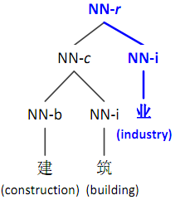
Joint Segmentation, POS-tagging and Constituent Parsing
Why character-based?
Deep character information of word structures.
Meishan Zhang, Yue Zhang, Wanxiang Che and Ting Liu. Chinese Parsing Exploiting Characters. In proceedings of ACL 2013. Sophia, Bulgaria. August.

Slide 154
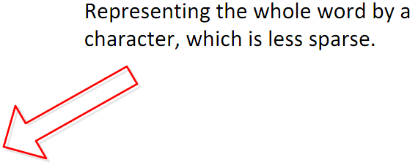
Joint Segmentation, POS-tagging and Constituent Parsing
Why character-based?
Deep character information of word structures.
Meishan Zhang, Yue Zhang, Wanxiang Che and Ting Liu. Chinese Parsing Exploiting Characters. In proceedings of ACL 2013. Sophia, Bulgaria. August.

Slide 155
Joint Segmentation, POS-tagging and Constituent Parsing
The character-based parsing model
A transition-based parser
Meishan Zhang, Yue Zhang, Wanxiang Che and Ting Liu. Chinese Parsing Exploiting Characters. In proceedings of ACL 2013. Sophia, Bulgaria. August.

Slide 156
Constituent Parsing
Transition-based Constituent Parsing
Example
SHIFT
stack
queue
DT
ADJ
NN
VV
ADJ
NNS
.
The
little
boy
likes
red
tomatoes
.
Yue Zhang and Stephen Clark. 2011. Syntactic Processing Using the Generalized Perceptron and Beam Search. In Computational Linguistics, 37(1), March.

Slide 157
Constituent Parsing
Transition-based Constituent Parsing
Example
SHIFT
stack
queue
DT
ADJ
NN
VV
ADJ
NNS
.
The
little
boy
likes
red
tomatoes
.
Yue Zhang and Stephen Clark. 2011. Syntactic Processing Using the Generalized Perceptron and Beam Search. In Computational Linguistics, 37(1), March.

Slide 158
Constituent Parsing
Transition-based Constituent Parsing
Example
SHIFT
stack
queue
DT
ADJ
NN
VV
ADJ
NNS
.
The
little
boy
likes
red
tomatoes
.
Yue Zhang and Stephen Clark. 2011. Syntactic Processing Using the Generalized Perceptron and Beam Search. In Computational Linguistics, 37(1), March.

Slide 159
Constituent Parsing
Transition-based Constituent Parsing
Example
REDUCE-R-NP
stack
queue
DT
ADJ
NN
VV
ADJ
NNS
.
The
little
boy
likes
red
tomatoes
.
Yue Zhang and Stephen Clark. 2011. Syntactic Processing Using the Generalized Perceptron and Beam Search. In Computational Linguistics, 37(1), March.

Slide 160
Constituent Parsing
Transition-based Constituent Parsing
Example
REDUCE-R-NP
stack
queue
DT
VV
ADJ
NNS
.
NP-r
The
likes
red
tomatoes
.
ADJ
NN
little
boy
Yue Zhang and Stephen Clark. 2011. Syntactic Processing Using the Generalized Perceptron and Beam Search. In Computational Linguistics, 37(1), March.

Slide 161
Constituent Parsing
Transition-based Constituent Parsing
Example
SHIFT
stack
queue
VV
ADJ
NNS
.
NP-r
likes
red
tomatoes
.
DT
NP-r
The
ADJ
NN
little
boy
Yue Zhang and Stephen Clark. 2011. Syntactic Processing Using the Generalized Perceptron and Beam Search. In Computational Linguistics, 37(1), March.

Slide 162
Constituent Parsing
Transition-based Constituent Parsing
Example
SHIFT
stack
queue
VV
ADJ
NNS
.
NP-r
likes
red
tomatoes
.
DT
NP-r
The
ADJ
NN
little
boy
Yue Zhang and Stephen Clark. 2011. Syntactic Processing Using the Generalized Perceptron and Beam Search. In Computational Linguistics, 37(1), March.

Slide 163
Constituent Parsing
Transition-based Constituent Parsing
Example
SHIFT
stack
queue
VV
ADJ
NNS
.
NP-r
likes
red
tomatoes
.
DT
NP-r
The
ADJ
NN
little
boy
Yue Zhang and Stephen Clark. 2011. Syntactic Processing Using the Generalized Perceptron and Beam Search. In Computational Linguistics, 37(1), March.

Slide 164
Constituent Parsing
Transition-based Constituent Parsing
Example
REDUCE-R-NP
stack
queue
VV
ADJ
NNS
.
NP-r
likes
red
tomatoes
.
DT
NP-r
The
ADJ
NN
little
boy
Yue Zhang and Stephen Clark. 2011. Syntactic Processing Using the Generalized Perceptron and Beam Search. In Computational Linguistics, 37(1), March.

Slide 165
Constituent Parsing
Transition-based Constituent Parsing
Example
REDUCE-L-NP
stack
queue
VV
.
NP-r
NP-r
likes
.
DT
NP-r
ADJ
NNS
The
red
tomatoes
ADJ
NN
little
boy
Yue Zhang and Stephen Clark. 2011. Syntactic Processing Using the Generalized Perceptron and Beam Search. In Computational Linguistics, 37(1), March.

Slide 166
Constituent Parsing
Transition-based Constituent Parsing
Example
SHIFT
stack
queue
.
NP-r
VP-l
.
DT
NP-r
VV
NP-r
The
likes
ADJ
NNS
ADJ
NN
little
boy
red
tomatoes
Yue Zhang and Stephen Clark. 2011. Syntactic Processing Using the Generalized Perceptron and Beam Search. In Computational Linguistics, 37(1), March.

Slide 167
Constituent Parsing
Transition-based Constituent Parsing
Example
REDUCE-L-S
stack
queue
.
NP-r
VP-l
.
DT
NP-r
VV
NP-r
The
likes
ADJ
NNS
ADJ
NN
little
boy
red
tomatoes
Yue Zhang and Stephen Clark. 2011. Syntactic Processing Using the Generalized Perceptron and Beam Search. In Computational Linguistics, 37(1), March.

Slide 168
Constituent Parsing
Transition-based Constituent Parsing
Example
REDUCE-R-S
stack
queue
NP-r
S-l
DT
NP-r
VP-l
.
The
VV
NP-r
.
ADJ
NN
little
boy
likes
ADJ
NNS
red
tomatoes
Yue Zhang and Stephen Clark. 2011. Syntactic Processing Using the Generalized Perceptron and Beam Search. In Computational Linguistics, 37(1), March.

Slide 169
Constituent Parsing
Transition-based Constituent Parsing
Example
TERMINATE
stack
queue
S-r
NP-r
S-l
DT
NP-r
VP-l
.
The
VV
NP-r
.
ADJ
NN
little
boy
likes
ADJ
NNS
red
tomatoes
Yue Zhang and Stephen Clark. 2011. Syntactic Processing Using the Generalized Perceptron and Beam Search. In Computational Linguistics, 37(1), March.

Slide 170
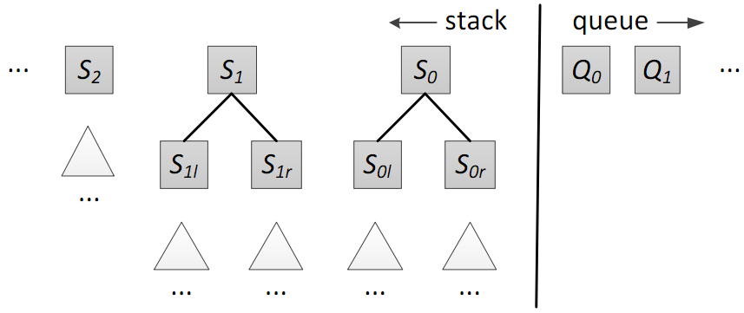
Joint Segmentation, POS-tagging and Constituent Parsing
The transition system
State:
Actions:
SHIFT-SEPARATE(t), SHIFT-APPEND, REDUCE-SUBWORD(d), REDUCE-WORD, REDUCE-BINARY(d;l), REDUCE-UNARY(l), TERMINATE
Meishan Zhang, Yue Zhang, Wanxiang Che and Ting Liu. Chinese Parsing Exploiting Characters. In proceedings of ACL 2013. Sophia, Bulgaria. August.

Slide 171
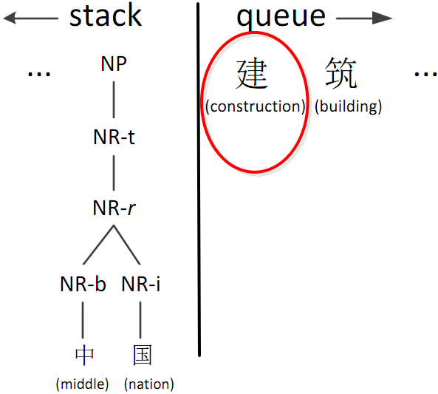
Joint Segmentation, POS-tagging and Constituent Parsing
Actions
SHIFT-SEPARATE(t)
Meishan Zhang, Yue Zhang, Wanxiang Che and Ting Liu. Chinese Parsing Exploiting Characters. In proceedings of ACL 2013. Sophia, Bulgaria. August.

Slide 172
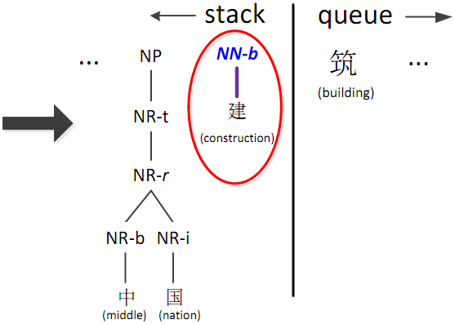
Joint Segmentation, POS-tagging and Constituent Parsing
Actions
SHIFT-SEPARATE(t)
Meishan Zhang, Yue Zhang, Wanxiang Che and Ting Liu. Chinese Parsing Exploiting Characters. In proceedings of ACL 2013. Sophia, Bulgaria. August.

Slide 173
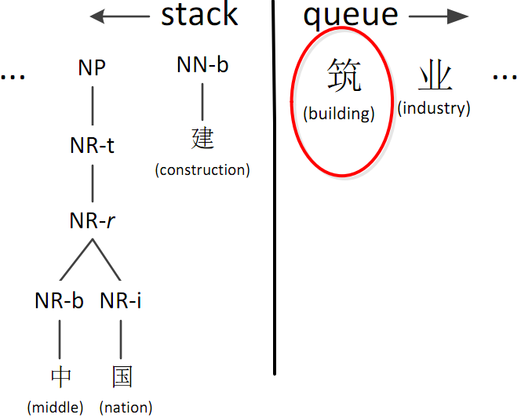
Joint Segmentation, POS-tagging and Constituent Parsing
Actions
SHIFT-APPEND
Meishan Zhang, Yue Zhang, Wanxiang Che and Ting Liu. Chinese Parsing Exploiting Characters. In proceedings of ACL 2013. Sophia, Bulgaria. August.

Slide 174
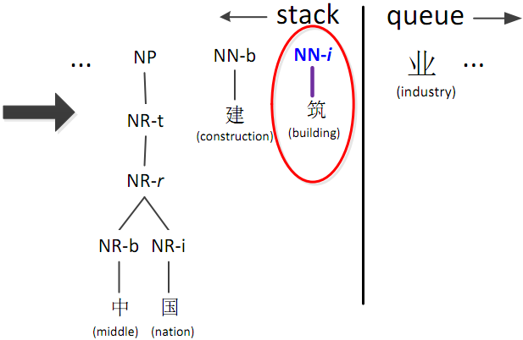
Joint Segmentation, POS-tagging and Constituent Parsing
Actions
SHIFT-APPEND
Meishan Zhang, Yue Zhang, Wanxiang Che and Ting Liu. Chinese Parsing Exploiting Characters. In proceedings of ACL 2013. Sophia, Bulgaria. August.

Slide 175
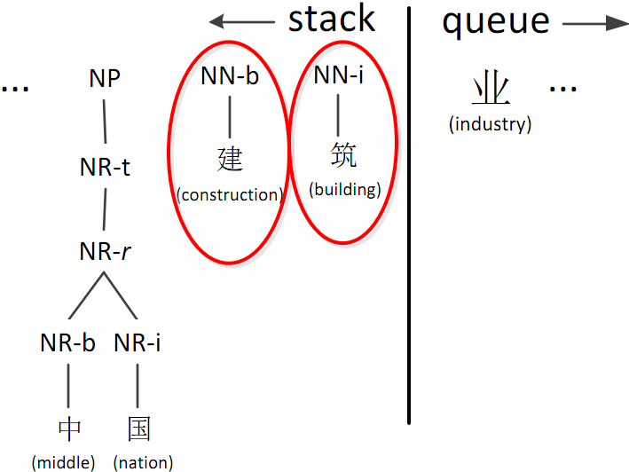
Joint Segmentation, POS-tagging and Constituent Parsing
Actions
REDUCE-SUBWORD(d)
Meishan Zhang, Yue Zhang, Wanxiang Che and Ting Liu. Chinese Parsing Exploiting Characters. In proceedings of ACL 2013. Sophia, Bulgaria. August.

Slide 176
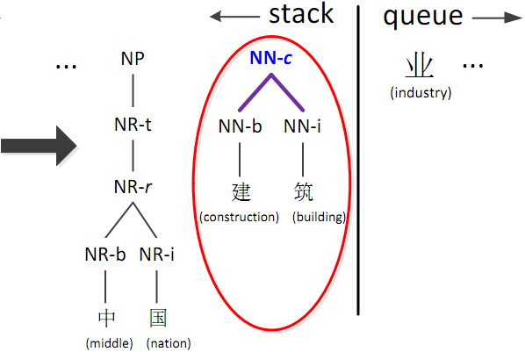
Joint Segmentation, POS-tagging and Constituent Parsing
Actions
REDUCE-SUBWORD(d)
Meishan Zhang, Yue Zhang, Wanxiang Che and Ting Liu. Chinese Parsing Exploiting Characters. In proceedings of ACL 2013. Sophia, Bulgaria. August.

Slide 177
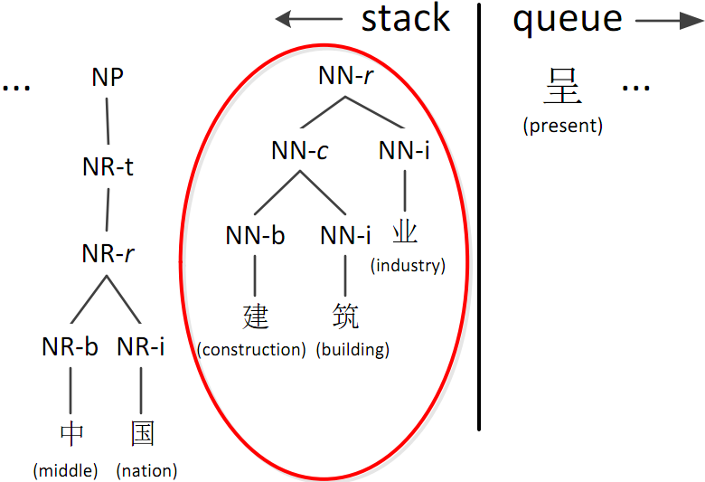
Joint Segmentation, POS-tagging and Constituent Parsing
Actions
REDUCE-WORD
Meishan Zhang, Yue Zhang, Wanxiang Che and Ting Liu. Chinese Parsing Exploiting Characters. In proceedings of ACL 2013. Sophia, Bulgaria. August.

Slide 178
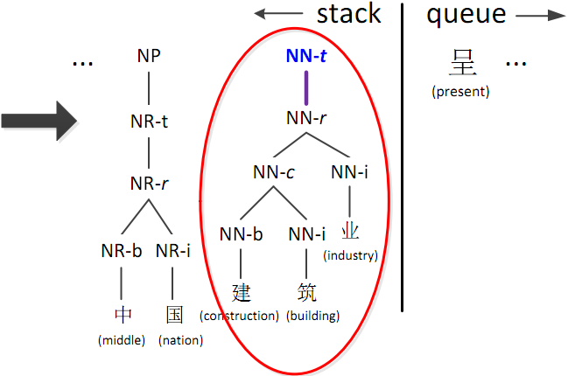
Joint Segmentation, POS-tagging and Constituent Parsing
Actions
REDUCE-WORD
Meishan Zhang, Yue Zhang, Wanxiang Che and Ting Liu. Chinese Parsing Exploiting Characters. In proceedings of ACL 2013. Sophia, Bulgaria. August.

Slide 179
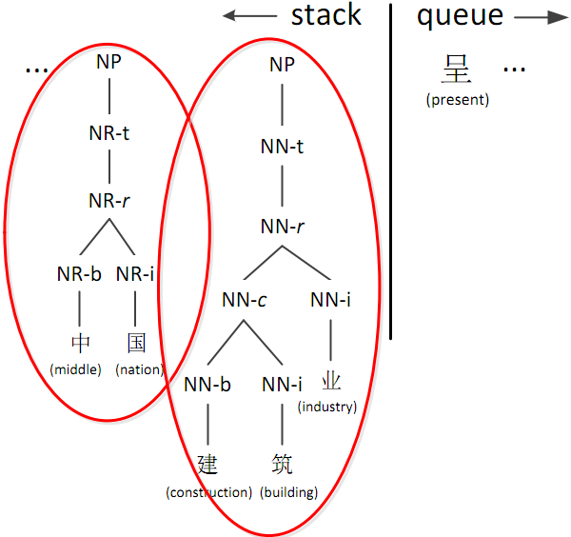
Joint Segmentation, POS-tagging and Constituent Parsing
Actions
REDUCE-BINARY(d; l)
Meishan Zhang, Yue Zhang, Wanxiang Che and Ting Liu. Chinese Parsing Exploiting Characters. In proceedings of ACL 2013. Sophia, Bulgaria. August.

Slide 180

Joint Segmentation, POS-tagging and Constituent Parsing
Actions
REDUCE-BINARY(d; l)
Meishan Zhang, Yue Zhang, Wanxiang Che and Ting Liu. Chinese Parsing Exploiting Characters. In proceedings of ACL 2013. Sophia, Bulgaria. August.

Slide 181

Joint Segmentation, POS-tagging and Constituent Parsing
Actions
REDUCE-UNARY(l)
Meishan Zhang, Yue Zhang, Wanxiang Che and Ting Liu. Chinese Parsing Exploiting Characters. In proceedings of ACL 2013. Sophia, Bulgaria. August.

Slide 182

Joint Segmentation, POS-tagging and Constituent Parsing
Actions
REDUCE-UNARY(l)
Meishan Zhang, Yue Zhang, Wanxiang Che and Ting Liu. Chinese Parsing Exploiting Characters. In proceedings of ACL 2013. Sophia, Bulgaria. August.

Slide 183

Joint Segmentation, POS-tagging and Constituent Parsing
Actions
TERMINATE
Meishan Zhang, Yue Zhang, Wanxiang Che and Ting Liu. Chinese Parsing Exploiting Characters. In proceedings of ACL 2013. Sophia, Bulgaria. August.

Slide 184

Joint Segmentation, POS-tagging and Constituent Parsing
Features
Meishan Zhang, Yue Zhang, Wanxiang Che and Ting Liu. Chinese Parsing Exploiting Characters. In proceedings of ACL 2013. Sophia, Bulgaria. August.

Slide 185

Joint Segmentation, POS-tagging and Constituent Parsing
Features
Meishan Zhang, Yue Zhang, Wanxiang Che and Ting Liu. Chinese Parsing Exploiting Characters. In proceedings of ACL 2013. Sophia, Bulgaria. August.

Slide 186
Joint Segmentation, POS-tagging and Constituent Parsing
 | Task | P | R | F
Results on CTB
Pipeline | Seg | 97.35 | 98.02 | 97.69
 | Tag | 93.51 | 94.15 | 93.83
 | Parse | 81.58 | 82.95 | 82.26
Flat word | Seg | 97.32 | 98.13 | 97.73
structures | Tag | 94.09 | 94.88 | 94.48
 | Parse | 83.39 | 83.84 | 83.61
Annotated | Seg | 97.49 | 98.18 | 97.84
word structures | Tag | 94.46 | 95.14 | 94.80
 | Parse | 84.42 | 84.43 | 84.43
 | WS | 94.02 | 94.69 | 94.35
Meishan Zhang, Yue Zhang, Wanxiang Che and Ting Liu. Chinese Parsing Exploiting Characters. In proceedings of ACL 2013. Sophia, Bulgaria. August.

Slide 187
Joint Segmentation, POS-tagging and Constituent Parsing
Results on CTB
Task | Seg | Tag | Parse
Kruengkrai+ ’09 | 97.87 | 93.67 | –
Sun ’11 | 98.17 | 94.02 | –
Wang+ ’11 | 98.11 | 94.18 | –
Li ’11 | 97.3 | 93.5 | 79.7
Li+ ’12 | 97.50 | 93.31 | –
Hatori+ ’12 | 98.26 | 94.64 | –
Qian+ ’12 | 97.96 | 93.81 | 82.85
Ours pipeline | 97.69 | 93.83 | 82.26
Ours joint flat | 97.73 | 94.48 | 83.61
Ours joint annotated | 97.84 | 94.80 | 84.43
Meishan Zhang, Yue Zhang, Wanxiang Che and Ting Liu. Chinese Parsing Exploiting Characters. In proceedings of ACL 2013. Sophia, Bulgaria. August.

Slide 188
Joint POS tagging and Dependency Parsing
Actions
INITIALIZATION
Stack [S]
Buffer [B]
He₁ won₂ the₃ game₄
Bohnet, Bernd, and Joakim Nivre. "A transition-based system for joint part-of-speech tagging and labeled non-projective dependency parsing." Proceedings of the 2012 Joint Conference on EMNLP and CoNLL. ACL, 2012.

Slide 189
Joint POS tagging and Dependency Parsing
Actions
SHIFT
Stack [S]
Buffer [B]
He₁
won₂ the₃ game₄
Bohnet, Bernd, and Joakim Nivre. "A transition-based system for joint part-of-speech tagging and labeled non-projective dependency parsing." Proceedings of the 2012 Joint Conference on EMNLP and CoNLL. ACL, 2012.

Slide 190
Joint POS tagging and Dependency Parsing
Actions
TAG_{PRP}
Stack [S]
Buffer [B]
He_{1/PRP}
won₂ the₃ game₄
Bohnet, Bernd, and Joakim Nivre. "A transition-based system for joint part-of-speech tagging and labeled non-projective dependency parsing." Proceedings of the 2012 Joint Conference on EMNLP and CoNLL. ACL, 2012.

Slide 191
Joint POS tagging and Dependency Parsing
Actions
SHIFT
Stack [S]
Buffer [B]
He_{1/PRP} won₂
the₃ game₄
Bohnet, Bernd, and Joakim Nivre. "A transition-based system for joint part-of-speech tagging and labeled non-projective dependency parsing." Proceedings of the 2012 Joint Conference on EMNLP and CoNLL. ACL, 2012.

Slide 192
Joint POS tagging and Dependency Parsing
Actions
TAG_{VBD}
Stack [S]
Buffer [B]
He_{1/PRP} won_{2/VBD}
the₃ game₄
Bohnet, Bernd, and Joakim Nivre. "A transition-based system for joint part-of-speech tagging and labeled non-projective dependency parsing." Proceedings of the 2012 Joint Conference on EMNLP and CoNLL. ACL, 2012.

Slide 193
Joint POS tagging and Dependency Parsing
Actions
LEFT
Stack [S]
Buffer [B]
He_{1/PRP} won_{2/VBD}
the₃ game₄
Bohnet, Bernd, and Joakim Nivre. "A transition-based system for joint part-of-speech tagging and labeled non-projective dependency parsing." Proceedings of the 2012 Joint Conference on EMNLP and CoNLL. ACL, 2012.

Slide 194
Joint POS tagging and Dependency Parsing
Actions
LABEL_{nsubj}
Stack [S]
Buffer [B]
He_{1/PRP} won_{2/VBD}
the₃ game₄
nusbj
Bohnet, Bernd, and Joakim Nivre. "A transition-based system for joint part-of-speech tagging and labeled non-projective dependency parsing." Proceedings of the 2012 Joint Conference on EMNLP and CoNLL. ACL, 2012.

Slide 195
Joint POS tagging and Dependency Parsing
Actions
SHIFT
Stack [S]
Buffer [B]
He_{1/PRP} won_{2/VBD} the₃
game₄
nusbj
Bohnet, Bernd, and Joakim Nivre. "A transition-based system for joint part-of-speech tagging and labeled non-projective dependency parsing." Proceedings of the 2012 Joint Conference on EMNLP and CoNLL. ACL, 2012.

Slide 196
Joint POS tagging and Dependency Parsing
Actions
TAG_{DT}
Stack [S]
Buffer [B]
He_{1/PRP} won_{2/VBD} the_{3/DT}
game₄
nusbj
Bohnet, Bernd, and Joakim Nivre. "A transition-based system for joint part-of-speech tagging and labeled non-projective dependency parsing." Proceedings of the 2012 Joint Conference on EMNLP and CoNLL. ACL, 2012.

Slide 197
Joint POS tagging and Dependency Parsing
Actions
SHIFT
Stack [S]
Buffer [B]
He_{1/PRP} won_{2/VBD} the_{3/DT} game₄
nusbj
Bohnet, Bernd, and Joakim Nivre. "A transition-based system for joint part-of-speech tagging and labeled non-projective dependency parsing." Proceedings of the 2012 Joint Conference on EMNLP and CoNLL. ACL, 2012.

Slide 198
Joint POS tagging and Dependency Parsing
Actions
TAG_{NN}
Stack [S]
Buffer [B]
He_{1/PRP} won_{2/VBD} the_{3/DT} game_{4/NN}
nusbj
Bohnet, Bernd, and Joakim Nivre. "A transition-based system for joint part-of-speech tagging and labeled non-projective dependency parsing." Proceedings of the 2012 Joint Conference on EMNLP and CoNLL. ACL, 2012.

Slide 199
Joint POS tagging and Dependency Parsing
Actions
LEFT
Stack [S]
Buffer [B]
He_{1/PRP} won_{2/VBD} the_{3/DT} game_{4/NN}
nusbj
Bohnet, Bernd, and Joakim Nivre. "A transition-based system for joint part-of-speech tagging and labeled non-projective dependency parsing." Proceedings of the 2012 Joint Conference on EMNLP and CoNLL. ACL, 2012.

Slide 200
Joint POS tagging and Dependency Parsing
Actions
LABEL_{det}
Stack [S]
Buffer [B]
He_{1/PRP} won_{2/VBD} the_{3/DT} game_{4/NN}
nusbj
det
Bohnet, Bernd, and Joakim Nivre. "A transition-based system for joint part-of-speech tagging and labeled non-projective dependency parsing." Proceedings of the 2012 Joint Conference on EMNLP and CoNLL. ACL, 2012.

Slide 201
Joint POS tagging and Dependency Parsing
Actions
RIGHT
Stack [S]
Buffer [B]
He_{1/PRP} won_{2/VBD} the_{3/DT} game_{4/NN}
nusbj
det
Bohnet, Bernd, and Joakim Nivre. "A transition-based system for joint part-of-speech tagging and labeled non-projective dependency parsing." Proceedings of the 2012 Joint Conference on EMNLP and CoNLL. ACL, 2012.

Slide 202
Joint POS tagging and Dependency Parsing
Actions
LABEL_{dobj}
Stack [S]
Buffer [B]
He_{1/PRP} won_{2/VBD} the_{3/DT} game_{4/NN}
nusbj
det
dobj
Bohnet, Bernd, and Joakim Nivre. "A transition-based system for joint part-of-speech tagging and labeled non-projective dependency parsing." Proceedings of the 2012 Joint Conference on EMNLP and CoNLL. ACL, 2012.

Slide 203

Joint Segmentation, POS-tagging and Dependency Parsing
Traditional word-based dependency parsing
Inter-word dependencies
Meishan Zhang, Yue Zhang, Wanxiang Che and Ting Liu. Character-Level Chinese Dependency Parsing. In Proceedings of ACL 2014. Baltimore, USA, June.
Jun Hatori, Takuya Matsuzaki, Yusuke Miyao, Jun’ichi Tsujii. Incremental Joint Approach to Chinese Word Segmentation, POS Tagging, and Dependency Parsing. In the Proceedings of ACL. Jeju, Korea. 2012.

Slide 204

Joint Segmentation, POS-tagging and Dependency Parsing
Character-level dependency parsing
Inter- and intra-word dependencies
Meishan Zhang, Yue Zhang, Wanxiang Che and Ting Liu. Character-Level Chinese Dependency Parsing. In Proceedings of ACL 2014. Baltimore, USA, June.
Jun Hatori, Takuya Matsuzaki, Yusuke Miyao, Jun’ichi Tsujii. Incremental Joint Approach to Chinese Word Segmentation, POS Tagging, and Dependency Parsing. In the Proceedings of ACL. Jeju, Korea. 2012.

Slide 205
Joint Segmentation, POS-tagging and Dependency Parsing
Extensions from word-level transition-based dependency parsing models
Arc-standard (Nirve 2008; Huang et al., 2009 )
Arc-eager (Nirve 2008; Zhang and Clark, 2008)
Meishan Zhang, Yue Zhang, Wanxiang Che and Ting Liu. Character-Level Chinese Dependency Parsing. In Proceedings of ACL 2014. Baltimore, USA, June.
Jun Hatori, Takuya Matsuzaki, Yusuke Miyao, Jun’ichi Tsujii. Incremental Joint Approach to Chinese Word Segmentation, POS Tagging, and Dependency Parsing. In the Proceedings of ACL. Jeju, Korea. 2012.

Slide 206

Joint Segmentation, POS-tagging and Dependency Parsing
Word-level transition-based dependency parsing
Arc-standard
Meishan Zhang, Yue Zhang, Wanxiang Che and Ting Liu. Character-Level Chinese Dependency Parsing. In Proceedings of ACL 2014. Baltimore, USA, June.
Jun Hatori, Takuya Matsuzaki, Yusuke Miyao, Jun’ichi Tsujii. Incremental Joint Approach to Chinese Word Segmentation, POS Tagging, and Dependency Parsing. In the Proceedings of ACL. Jeju, Korea. 2012.

Slide 207


Joint Segmentation, POS-tagging and Dependency Parsing
Word-level to character-level
Arc-standard
Meishan Zhang, Yue Zhang, Wanxiang Che and Ting Liu. Character-Level Chinese Dependency Parsing. In Proceedings of ACL 2014. Baltimore, USA, June.
Jun Hatori, Takuya Matsuzaki, Yusuke Miyao, Jun’ichi Tsujii. Incremental Joint Approach to Chinese Word Segmentation, POS Tagging, and Dependency Parsing. In the Proceedings of ACL. Jeju, Korea. 2012.

Slide 208

Joint Segmentation, POS-tagging and Dependency Parsing
Word-level transition-based dependency parsing
Arc-eager
Meishan Zhang, Yue Zhang, Wanxiang Che and Ting Liu. Character-Level Chinese Dependency Parsing. In Proceedings of ACL 2014. Baltimore, USA, June.
Jun Hatori, Takuya Matsuzaki, Yusuke Miyao, Jun’ichi Tsujii. Incremental Joint Approach to Chinese Word Segmentation, POS Tagging, and Dependency Parsing. In the Proceedings of ACL. Jeju, Korea. 2012.

Slide 209


Joint Segmentation, POS-tagging and Dependency Parsing
Word-level to character-level
Arc-eager
Meishan Zhang, Yue Zhang, Wanxiang Che and Ting Liu. Character-Level Chinese Dependency Parsing. In Proceedings of ACL 2014. Baltimore, USA, June.
Jun Hatori, Takuya Matsuzaki, Yusuke Miyao, Jun’ichi Tsujii. Incremental Joint Approach to Chinese Word Segmentation, POS Tagging, and Dependency Parsing. In the Proceedings of ACL. Jeju, Korea. 2012.

Slide 210



Joint Segmentation, POS-tagging and Dependency Parsing
New features
Meishan Zhang, Yue Zhang, Wanxiang Che and Ting Liu. Character-Level Chinese Dependency Parsing. In Proceedings of ACL 2014. Baltimore, USA, June.
Jun Hatori, Takuya Matsuzaki, Yusuke Miyao, Jun’ichi Tsujii. Incremental Joint Approach to Chinese Word Segmentation, POS Tagging, and Dependency Parsing. In the Proceedings of ACL. Jeju, Korea. 2012.

Slide 211

Joint Segmentation, POS-tagging and Dependency Parsing
Results on CTB
Meishan Zhang, Yue Zhang, Wanxiang Che and Ting Liu. Character-Level Chinese Dependency Parsing. In Proceedings of ACL 2014. Baltimore, USA, June.
Jun Hatori, Takuya Matsuzaki, Yusuke Miyao, Jun’ichi Tsujii. Incremental Joint Approach to Chinese Word Segmentation, POS Tagging, and Dependency Parsing. In the Proceedings of ACL. Jeju, Korea. 2012.

Slide 212
Joint Morphology and Linearization
Task
Input
Output: meanwhile, prices are thought to have increased.
Ratish Puduppully, Yue Zhang, Manish Shrivastava. Transition-Based Deep Input Linearization. In Proceedings of the 15th Conference of the European Chapter of the Association for Computational Linguistics (EACL). Valencia, Spain, April.

Slide 213
Joint Morphology and Linearization
Model
NLG pipeline with deep input graph
Pipeline based on the meaning text theory
This paper
Ratish Puduppully, Yue Zhang, Manish Shrivastava. Transition-Based Deep Input Linearization. In Proceedings of the 15th Conference of the European Chapter of the Association for Computational Linguistics (EACL). Valencia, Spain, April.

Slide 214
Joint Morphology and Linearization
Transition Actions
SHIFT-Word-POS [SH]
Shifts Word from ρ, as- signs POS to it and pushes it to top of stack as S₀;
LEFTARC-LABEL [LA]
Constructs dependency arc S₁ S₀ and pops out second element from top of stack S₁
RIGHTARD-LABEL [RA]
Constructs dependency arc S₁ S₀ and pops out top of stack S₀
INSERT [IN]
Inserts comma at the present position
SPLITARC-Word [SP]
splits an arc in the input graph C, inserting a function word between the words connected by the arc.
LABEL
LABEL
Ratish Puduppully, Yue Zhang, Manish Shrivastava. Transition-Based Deep Input Linearization. In Proceedings of the 15th Conference of the European Chapter of the Association for Computational Linguistics (EACL). Valencia, Spain, April.

Slide 215
Joint Morphology and Linearization
Transition Example
Input
Lemmas:
think_{[1]} price_{[2]} ._{[3]} increase_{[4]} be_{[5]} have_{[6]} meanwhile_{[7]}
Ratish Puduppully, Yue Zhang, Manish Shrivastava. Transition-Based Deep Input Linearization. In Proceedings of the 15th Conference of the European Chapter of the Association for Computational Linguistics (EACL). Valencia, Spain, April.

Slide 216
Joint Morphology and Linearization
think_{[1]} price_{[2]} ._{[3]} increase_{[4]} be_{[5]} have_{[6]} meanwhile_{[7]}
Transition Action
σ
ρ
1 2 3 4 5 6 7
Ratish Puduppully, Yue Zhang, Manish Shrivastava. Transition-Based Deep Input Linearization. In Proceedings of the 15th Conference of the European Chapter of the Association for Computational Linguistics (EACL). Valencia, Spain, April.

Slide 217
Joint Morphology and Linearization
think_{[1]} price_{[2]} ._{[3]} increase_{[4]} be_{[5]} have_{[6]} meanwhile_{[7]}
Transition Action
SH-meanwhile
Meanwhile
σ
ρ
7
1 2 3 4 5 6
Ratish Puduppully, Yue Zhang, Manish Shrivastava. Transition-Based Deep Input Linearization. In Proceedings of the 15th Conference of the European Chapter of the Association for Computational Linguistics (EACL). Valencia, Spain, April.

Slide 218
Joint Morphology and Linearization
think_{[1]} price_{[2]} ._{[3]} increase_{[4]} be_{[5]} have_{[6]} meanwhile_{[7]}
Transition Action
INSERT
Meanwhile ,
σ
ρ
7
1 2 3 4 5 6
Ratish Puduppully, Yue Zhang, Manish Shrivastava. Transition-Based Deep Input Linearization. In Proceedings of the 15th Conference of the European Chapter of the Association for Computational Linguistics (EACL). Valencia, Spain, April.

Slide 219
Joint Morphology and Linearization
think_{[1]} price_{[2]} ._{[3]} increase_{[4]} be_{[5]} have_{[6]} meanwhile_{[7]}
Transition Action
SH-prices
Meanwhile , prices
σ
ρ
7 2
1 3 4 5 6
Ratish Puduppully, Yue Zhang, Manish Shrivastava. Transition-Based Deep Input Linearization. In Proceedings of the 15th Conference of the European Chapter of the Association for Computational Linguistics (EACL). Valencia, Spain, April.

Slide 220
Joint Morphology and Linearization
think_{[1]} price_{[2]} ._{[3]} increase_{[4]} be_{[5]} have_{[6]} meanwhile_{[7]}
Transition Action
SH-are
Meanwhile , prices are
σ
ρ
7 2 5
1 3 4 6
Ratish Puduppully, Yue Zhang, Manish Shrivastava. Transition-Based Deep Input Linearization. In Proceedings of the 15th Conference of the European Chapter of the Association for Computational Linguistics (EACL). Valencia, Spain, April.

Slide 221
Joint Morphology and Linearization
think_{[1]} price_{[2]} ._{[3]} increase_{[4]} be_{[5]} have_{[6]} meanwhile_{[7]}
Transition Action
SH-thought
Meanwhile , prices are thought
σ
ρ
7 2 5 1
3 4 6
Ratish Puduppully, Yue Zhang, Manish Shrivastava. Transition-Based Deep Input Linearization. In Proceedings of the 15th Conference of the European Chapter of the Association for Computational Linguistics (EACL). Valencia, Spain, April.

Slide 222
Joint Morphology and Linearization
think_{[1]} price_{[2]} ._{[3]} increase_{[4]} be_{[5]} have_{[6]} meanwhile_{[7]}
Transition Action
SH-to
Meanwhile , prices are thought to
σ
ρ
7 2 5 1
3 4 6
Ratish Puduppully, Yue Zhang, Manish Shrivastava. Transition-Based Deep Input Linearization. In Proceedings of the 15th Conference of the European Chapter of the Association for Computational Linguistics (EACL). Valencia, Spain, April.

Slide 223
Joint Morphology and Linearization
think_{[1]} price_{[2]} ._{[3]} increase_{[4]} be_{[5]} have_{[6]} meanwhile_{[7]}
Transition Action
SH-have
Meanwhile , prices are thought to have
σ
ρ
7 2 5 1 6
3 4
Ratish Puduppully, Yue Zhang, Manish Shrivastava. Transition-Based Deep Input Linearization. In Proceedings of the 15th Conference of the European Chapter of the Association for Computational Linguistics (EACL). Valencia, Spain, April.

Slide 224
Joint Morphology and Linearization
think_{[1]} price_{[2]} ._{[3]} increase_{[4]} be_{[5]} have_{[6]} meanwhile_{[7]}
Transition Action
SH-increased
Meanwhile , prices are thought to have increased
σ
ρ
7 2 5 1 6 4
3
Ratish Puduppully, Yue Zhang, Manish Shrivastava. Transition-Based Deep Input Linearization. In Proceedings of the 15th Conference of the European Chapter of the Association for Computational Linguistics (EACL). Valencia, Spain, April.

Slide 225
Joint Morphology and Linearization
think_{[1]} price_{[2]} ._{[3]} increase_{[4]} be_{[5]} have_{[6]} meanwhile_{[7]}
Transition Action
RA (6 → 4) [VC]
VC
Meanwhile , prices are thought to have increased
σ
ρ
7 2 5 1 6 4
3
Ratish Puduppully, Yue Zhang, Manish Shrivastava. Transition-Based Deep Input Linearization. In Proceedings of the 15th Conference of the European Chapter of the Association for Computational Linguistics (EACL). Valencia, Spain, April.

Slide 226
Joint Morphology and Linearization
think_{[1]} price_{[2]} ._{[3]} increase_{[4]} be_{[5]} have_{[6]} meanwhile_{[7]}
Transition Action
RA (1 → 6) [C-A1]
C-A1
VC
Meanwhile , prices are thought to have increased
σ
ρ
7 2 5 1 6
3
Ratish Puduppully, Yue Zhang, Manish Shrivastava. Transition-Based Deep Input Linearization. In Proceedings of the 15th Conference of the European Chapter of the Association for Computational Linguistics (EACL). Valencia, Spain, April.

Slide 227
Joint Morphology and Linearization
think_{[1]} price_{[2]} ._{[3]} increase_{[4]} be_{[5]} have_{[6]} meanwhile_{[7]}
Transition Action
RA (5 → 1) [VC]
VC
C-A1
VC
Meanwhile , prices are thought to have increased
σ
ρ
7 2 5 1
3
Ratish Puduppully, Yue Zhang, Manish Shrivastava. Transition-Based Deep Input Linearization. In Proceedings of the 15th Conference of the European Chapter of the Association for Computational Linguistics (EACL). Valencia, Spain, April.

Slide 228
Joint Morphology and Linearization
think_{[1]} price_{[2]} ._{[3]} increase_{[4]} be_{[5]} have_{[6]} meanwhile_{[7]}
Transition Action
SH-.
VC
C-A1
VC
Meanwhile , prices are thought to have increased .
σ
ρ
7 2 5
3
Ratish Puduppully, Yue Zhang, Manish Shrivastava. Transition-Based Deep Input Linearization. In Proceedings of the 15th Conference of the European Chapter of the Association for Computational Linguistics (EACL). Valencia, Spain, April.

Slide 229
Joint Morphology and Linearization
think_{[1]} price_{[2]} ._{[3]} increase_{[4]} be_{[5]} have_{[6]} meanwhile_{[7]}
Transition Action
RA (5 → 3) [P]
VC
C-A1
VC
Meanwhile , prices are thought to have increased .
P
σ
ρ
7 2 5 3
Ratish Puduppully, Yue Zhang, Manish Shrivastava. Transition-Based Deep Input Linearization. In Proceedings of the 15th Conference of the European Chapter of the Association for Computational Linguistics (EACL). Valencia, Spain, April.

Slide 230
Joint Morphology and Linearization
think_{[1]} price_{[2]} ._{[3]} increase_{[4]} be_{[5]} have_{[6]} meanwhile_{[7]}
Transition Action
LA (2 ← 5) [SBJ]
SBJ
VC
C-A1
VC
Meanwhile , prices are thought to have increased .
P
σ
ρ
7 2 5
Ratish Puduppully, Yue Zhang, Manish Shrivastava. Transition-Based Deep Input Linearization. In Proceedings of the 15th Conference of the European Chapter of the Association for Computational Linguistics (EACL). Valencia, Spain, April.

Slide 231
Joint Morphology and Linearization
think_{[1]} price_{[2]} ._{[3]} increase_{[4]} be_{[5]} have_{[6]} meanwhile_{[7]}
Transition Action
LA (7 ← 5) [AM-TMP]
SBJ
VC
C-A1
VC
Meanwhile , prices are thought to have increased .
AM-TMP
P
σ
ρ
5
Ratish Puduppully, Yue Zhang, Manish Shrivastava. Transition-Based Deep Input Linearization. In Proceedings of the 15th Conference of the European Chapter of the Association for Computational Linguistics (EACL). Valencia, Spain, April.

Slide 232
Joint Morphology and Linearization
Results on dataset of the Surface Realisation Shared Task
Ratish Puduppully, Yue Zhang, Manish Shrivastava. Transition-Based Deep Input Linearization. In Proceedings of the 15th Conference of the European Chapter of the Association for Computational Linguistics (EACL). Valencia, Spain, April.

Slide 233
Joint Entity and Relation Extraction
Task: simultaneously extracting drugs, diseases and adverse drug events.
Gliclazide_{drug}-induced acute hepatitis_{disease}
Fei Li, Yue Zhang, Meishan Zhang and Donghong Ji. Joint Models for Extracting Adverse Drug Events from Biomedical Text. In Proceddings of IJCAI 2016. New York City, USA, July.

Slide 234
Joint Entity and Relation Extraction
Entity actions:
O, which marks the current word as not belong to either a drug or disease mention.
BC, which marks the current word as the beginning of a drug mention.
BD, which marks the current word as the beginning of a disease mention.
I, which marks the current word as part of a drug or disease mention but not the beginning.
For example
Given a sentence: Gliclazide-induced acute hepatitis.
The action sequence: “BC O O BD I O “ yields the result ”Gliclazide_{drug}-induced acute hepatitis_{disease}.”
Fei Li, Yue Zhang, Meishan Zhang and Donghong Ji. Joint Models for Extracting Adverse Drug Events from Biomedical Text. In Proceddings of IJCAI 2016. New York City, USA, July.

Slide 235
Joint Entity and Relation Extraction
Relation actions
N, which indicates that a pair of entities does not have an ADE relation
Y, which indicates that a pair of entities has an ADE relation
Fei Li, Yue Zhang, Meishan Zhang and Donghong Ji. Joint Models for Extracting Adverse Drug Events from Biomedical Text. In Proceddings of IJCAI 2016. New York City, USA, July.

Slide 236
Joint Entity and Relation Extraction
The state of the joint model as a tuple <labels, disease, drugs, s ADEs>
labels is a label sequence
disease is a list of readily-recognized disease entity mentions
drugs is a list of readily-recognized drug entity mentions
ADEs is a set of ADEs
Fei Li, Yue Zhang, Meishan Zhang and Donghong Ji. Joint Models for Extracting Adverse Drug Events from Biomedical Text. In Proceddings of IJCAI 2016. New York City, USA, July.

Slide 237
Joint Entity and Relation Extraction
State transition examples
Hepatitis caused by methotrexate and etretinate .
BD O O BC O BC O
state
next action
<labels, disease, drugs, relations>
<[],[],[],[]>
BD
Fei Li, Yue Zhang, Meishan Zhang and Donghong Ji. Joint Models for Extracting Adverse Drug Events from Biomedical Text. In Proceddings of IJCAI 2016. New York City, USA, July.

Slide 238
Joint Entity and Relation Extraction
State transition examples
Hepatitis caused by methotrexate and etretinate .
BD O O BC O BC O
state
next action
<labels, disease, drugs, relations>
<[BD],[],[],[]>
O
Fei Li, Yue Zhang, Meishan Zhang and Donghong Ji. Joint Models for Extracting Adverse Drug Events from Biomedical Text. In Proceddings of IJCAI 2016. New York City, USA, July.

Slide 239
Joint Entity and Relation Extraction
State transition examples
Hepatitis caused by methotrexate and etretinate .
BD O O BC O BC O
state
next action
<labels, disease, drugs, relations>
<[BD,O],[Hepatitis],[],[]>
O
Fei Li, Yue Zhang, Meishan Zhang and Donghong Ji. Joint Models for Extracting Adverse Drug Events from Biomedical Text. In Proceddings of IJCAI 2016. New York City, USA, July.

Slide 240
Joint Entity and Relation Extraction
State transition examples
Hepatitis caused by methotrexate and etretinate .
BD O O BC O BC O
state
next action
<labels, disease, drugs, relations>
<[BD,O,O],[Hepatitis],[],[]>
BC
Fei Li, Yue Zhang, Meishan Zhang and Donghong Ji. Joint Models for Extracting Adverse Drug Events from Biomedical Text. In Proceddings of IJCAI 2016. New York City, USA, July.

Slide 241
Joint Entity and Relation Extraction
State transition examples
Hepatitis caused by methotrexate and etretinate .
BD O O BC O BC O
state
next action
<labels, disease, drugs, relations>
<[BD,O,O,BC],[Hepatitis],[],[]>
O
Fei Li, Yue Zhang, Meishan Zhang and Donghong Ji. Joint Models for Extracting Adverse Drug Events from Biomedical Text. In Proceddings of IJCAI 2016. New York City, USA, July.

Slide 242
Joint Entity and Relation Extraction
State transition examples
Hepatitis caused by methotrexate and etretinate .
BD O O BC O BC O
state
next action
<labels, disease, drugs, relations>
<[BD,O,O,BC,O],[Hepatitis],[methotrexate],[]>
Y
Fei Li, Yue Zhang, Meishan Zhang and Donghong Ji. Joint Models for Extracting Adverse Drug Events from Biomedical Text. In Proceddings of IJCAI 2016. New York City, USA, July.

Slide 243
Joint Entity and Relation Extraction
State transition examples
Hepatitis caused by methotrexate and etretinate .
BD O O BC O BC O
state
next action
<labels, disease, drugs, relations>
<[BD,O,O,BC,O,Y],[Hepatitis],[methotrexate],[(Hepatitis,methotrexate)]>
BC
Fei Li, Yue Zhang, Meishan Zhang and Donghong Ji. Joint Models for Extracting Adverse Drug Events from Biomedical Text. In Proceddings of IJCAI 2016. New York City, USA, July.

Slide 244
Joint Entity and Relation Extraction
State transition examples
Hepatitis caused by methotrexate and etretinate .
BD O O BC O BC O
state
next action
<labels, disease, drugs, relations>
<[BD,O,O,BC,O,Y,BC],[Hepatitis],[methotrexate],[(Hepatitis,methotrexate)]>
O
Fei Li, Yue Zhang, Meishan Zhang and Donghong Ji. Joint Models for Extracting Adverse Drug Events from Biomedical Text. In Proceddings of IJCAI 2016. New York City, USA, July.

Slide 245
Joint Entity and Relation Extraction
State transition examples
Hepatitis caused by methotrexate and etretinate .
BD O O BC O BC O
state
next action
<labels, disease, drugs, relations>
<[BD,O,O,BC,O,Y,BC,O],[Hepatitis],[methotrexate,etretinate],[(Hepatitis,methotrexate)]>
Y
Fei Li, Yue Zhang, Meishan Zhang and Donghong Ji. Joint Models for Extracting Adverse Drug Events from Biomedical Text. In Proceddings of IJCAI 2016. New York City, USA, July.

Slide 246
Joint Entity and Relation Extraction
State transition examples
Hepatitis caused by methotrexate and etretinate .
BD O O BC O BC O
state
next action
<labels, disease, drugs, relations>
<[BD,O,O,BC,O,Y,BC,O,Y],[Hepatitis],[methotrexate,etretinate],[(Hepatitis,methotrexate),(Hepatitis,etretinate)]>
<EOS>
Fei Li, Yue Zhang, Meishan Zhang and Donghong Ji. Joint Models for Extracting Adverse Drug Events from Biomedical Text. In Proceddings of IJCAI 2016. New York City, USA, July.

Slide 247

Joint Entity and Relation Extraction
Results on ADE data
Fei Li, Yue Zhang, Meishan Zhang and Donghong Ji. Joint Models for Extracting Adverse Drug Events from Biomedical Text. In Proceddings of IJCAI 2016. New York City, USA, July.

Slide 248
Outline
Motivation
Statistical Models
Deep Learning Models

Slide 249
Deep Learning Models
Neural Transition-based Models
Neural Graph-based Models (Multi-task Learning)
Cross Task
Cross Domain
Cross Lingual
Cross Standard

Slide 250
Deep Learning Models
Neural Transition-based Models
Neural Graph-based Models (Multi-task Learning)
Cross Task
Cross Domain
Cross Lingual
Cross Standard
Joint Search
Joint Learning

Slide 251
Joint Entity and Relation Extraction
Model
Fei Li, Yue Zhang, Meishan Zhang and Donghong Ji. Joint Models for Extracting Adverse Drug Events from Biomedical Text. In Proceddings of IJCAI 2016. New York City, USA, July.

Slide 252
Joint Entity and Relation Extraction
Results
Fei Li, Yue Zhang, Meishan Zhang and Donghong Ji. Joint Models for Extracting Adverse Drug Events from Biomedical Text. In Proceddings of IJCAI 2016. New York City, USA, July.

Slide 253
Joint Parsing and SRL
Transition Action
all are expected to reopen soon root
Stack [S]
Buffer [M]
Queue [B]
all, are, expected, to, reopen, soon, root
Swabha Swayamdipta, Miguel Ballesteros, Chris Dyer and Noah A. Smith. Greedy, Joint Syntactic-Semantic Parsing with Stack LSTMs In proceedings of CoNLL (CoNLL 2016).

Slide 254
Joint Parsing and SRL
Transition Action
S-SHIFT
all are expected to reopen soon root
Stack [S]
Buffer [M]
Queue [B]
all
are, expected, to, reopen, soon, root
Swabha Swayamdipta, Miguel Ballesteros, Chris Dyer and Noah A. Smith. Greedy, Joint Syntactic-Semantic Parsing with Stack LSTMs In proceedings of CoNLL (CoNLL 2016).

Slide 255
Joint Parsing and SRL
Transition Action
M-SHIFT
all are expected to reopen soon root
Stack [S]
Buffer [M]
Queue [B]
all
all
are, expected, to, reopen, soon, root
Swabha Swayamdipta, Miguel Ballesteros, Chris Dyer and Noah A. Smith. Greedy, Joint Syntactic-Semantic Parsing with Stack LSTMs In proceedings of CoNLL (CoNLL 2016).

Slide 256
Joint Parsing and SRL
sbj
Transition Action
S-LEFT (sbj)
all are expected to reopen soon root
Stack [S]
Buffer [M]
Queue [B]
all
are, expected, to, reopen, soon, root
Swabha Swayamdipta, Miguel Ballesteros, Chris Dyer and Noah A. Smith. Greedy, Joint Syntactic-Semantic Parsing with Stack LSTMs In proceedings of CoNLL (CoNLL 2016).

Slide 257
Joint Parsing and SRL
sbj
Transition Action
S-SHIFT
all are expected to reopen soon root
Stack [S]
Buffer [M]
Queue [B]
are
all
are, expected, to, reopen, soon, root
Swabha Swayamdipta, Miguel Ballesteros, Chris Dyer and Noah A. Smith. Greedy, Joint Syntactic-Semantic Parsing with Stack LSTMs In proceedings of CoNLL (CoNLL 2016).

Slide 258
Joint Parsing and SRL
sbj
Transition Action
M-SHIFT
all are expected to reopen soon root
Stack [S]
Buffer [M]
Queue [B]
are
all, are
expected, to, reopen, soon, root
Swabha Swayamdipta, Miguel Ballesteros, Chris Dyer and Noah A. Smith. Greedy, Joint Syntactic-Semantic Parsing with Stack LSTMs In proceedings of CoNLL (CoNLL 2016).

Slide 259
Joint Parsing and SRL
sbj
vc
Transition Action
S-RIGHT (vc)
all are expected to reopen soon root
Stack [S]
Buffer [M]
Queue [B]
are, expected
all, are
expected, to, reopen, soon, root
Swabha Swayamdipta, Miguel Ballesteros, Chris Dyer and Noah A. Smith. Greedy, Joint Syntactic-Semantic Parsing with Stack LSTMs In proceedings of CoNLL (CoNLL 2016).

Slide 260
Joint Parsing and SRL
sbj
vc
Transition Action
M-PRED (expect.01)
all are expected to reopen soon root
Stack [S]
Buffer [M]
Queue [B]
are, expected
all, are
expected, to, reopen, soon, root
Swabha Swayamdipta, Miguel Ballesteros, Chris Dyer and Noah A. Smith. Greedy, Joint Syntactic-Semantic Parsing with Stack LSTMs In proceedings of CoNLL (CoNLL 2016).

Slide 261
Joint Parsing and SRL
sbj
vc
Transition Action
M-REDUCE
all are expected to reopen soon root
Stack [S]
Buffer [M]
Queue [B]
are, expected
all
expected, to, reopen, soon, root
Swabha Swayamdipta, Miguel Ballesteros, Chris Dyer and Noah A. Smith. Greedy, Joint Syntactic-Semantic Parsing with Stack LSTMs In proceedings of CoNLL (CoNLL 2016).

Slide 262
Joint Parsing and SRL
sbj
vc
Transition Action
M-LEFT(A1)
all are expected to reopen soon root
A1
Stack [S]
Buffer [M]
Queue [B]
are, expected
all
expected, to, reopen, soon, root
Swabha Swayamdipta, Miguel Ballesteros, Chris Dyer and Noah A. Smith. Greedy, Joint Syntactic-Semantic Parsing with Stack LSTMs In proceedings of CoNLL (CoNLL 2016).

Slide 263
Joint Parsing and SRL
sbj
vc
Transition Action
M-SHIFT
all are expected to reopen soon root
A1
Stack [S]
Buffer [M]
Queue [B]
are, expected
all, expected
to, reopen, soon, root
Swabha Swayamdipta, Miguel Ballesteros, Chris Dyer and Noah A. Smith. Greedy, Joint Syntactic-Semantic Parsing with Stack LSTMs In proceedings of CoNLL (CoNLL 2016).

Slide 264
Joint Parsing and SRL
sbj
vc
oprd
Transition Action
S-RIGHT (oprd)
all are expected to reopen soon root
A1
Stack [S]
Buffer [M]
Queue [B]
are, expected, to
all, expected
to, reopen, soon, root
Swabha Swayamdipta, Miguel Ballesteros, Chris Dyer and Noah A. Smith. Greedy, Joint Syntactic-Semantic Parsing with Stack LSTMs In proceedings of CoNLL (CoNLL 2016).

Slide 265
Joint Parsing and SRL
sbj
vc
oprd
Transition Action
M-RIGHT (C-A1)
all are expected to reopen soon root
A1
C-A1
Stack [S]
Buffer [M]
Queue [B]
are, expected, to
all, expected
to, reopen, soon, root
Swabha Swayamdipta, Miguel Ballesteros, Chris Dyer and Noah A. Smith. Greedy, Joint Syntactic-Semantic Parsing with Stack LSTMs In proceedings of CoNLL (CoNLL 2016).

Slide 266
Joint Parsing and SRL
sbj
vc
oprd
Transition Action
M-REDUCE
all are expected to reopen soon root
A1
C-A1
Stack [S]
Buffer [M]
Queue [B]
are, expected, to
all
to, reopen, soon, root
Swabha Swayamdipta, Miguel Ballesteros, Chris Dyer and Noah A. Smith. Greedy, Joint Syntactic-Semantic Parsing with Stack LSTMs In proceedings of CoNLL (CoNLL 2016).

Slide 267
Joint Parsing and SRL
sbj
vc
oprd
Transition Action
M-SHIFT
all are expected to reopen soon root
A1
C-A1
Stack [S]
Buffer [M]
Queue [B]
are, expected, to
all, to
reopen, soon, root
Swabha Swayamdipta, Miguel Ballesteros, Chris Dyer and Noah A. Smith. Greedy, Joint Syntactic-Semantic Parsing with Stack LSTMs In proceedings of CoNLL (CoNLL 2016).

Slide 268
Joint Parsing and SRL
sbj
vc
oprd
im
Transition Action
S-RIGHT (im)
all are expected to reopen soon root
A1
C-A1
Stack [S]
Buffer [M]
Queue [B]
are, expected, to, reopen
all, to
reopen, soon, root
Swabha Swayamdipta, Miguel Ballesteros, Chris Dyer and Noah A. Smith. Greedy, Joint Syntactic-Semantic Parsing with Stack LSTMs In proceedings of CoNLL (CoNLL 2016).

Slide 269
Joint Parsing and SRL
sbj
vc
oprd
im
Transition Action
M-PRED (reopen.01)
all are expected to reopen soon root
A1
C-A1
Stack [S]
Buffer [M]
Queue [B]
are, expected, to, reopen
all, to
reopen, soon, root
Swabha Swayamdipta, Miguel Ballesteros, Chris Dyer and Noah A. Smith. Greedy, Joint Syntactic-Semantic Parsing with Stack LSTMs In proceedings of CoNLL (CoNLL 2016).

Slide 270
Joint Parsing and SRL
sbj
vc
oprd
im
Transition Action
M-REDUCE
all are expected to reopen soon root
A1
C-A1
Stack [S]
Buffer [M]
Queue [B]
are, expected, to, reopen
all
reopen, soon, root
Swabha Swayamdipta, Miguel Ballesteros, Chris Dyer and Noah A. Smith. Greedy, Joint Syntactic-Semantic Parsing with Stack LSTMs In proceedings of CoNLL (CoNLL 2016).

Slide 271
Joint Parsing and SRL
sbj
vc
oprd
im
Transition Action
M-LEFT (A1)
all are expected to reopen soon root
A1
C-A1
A1
Stack [S]
Buffer [M]
Queue [B]
are, expected, to, reopen
all
reopen, soon, root
Swabha Swayamdipta, Miguel Ballesteros, Chris Dyer and Noah A. Smith. Greedy, Joint Syntactic-Semantic Parsing with Stack LSTMs In proceedings of CoNLL (CoNLL 2016).

Slide 272
Joint Parsing and SRL
sbj
vc
oprd
im
Transition Action
M-REDUCE
all are expected to reopen soon root
A1
C-A1
A1
Stack [S]
Buffer [M]
Queue [B]
are, expected, to, reopen
reopen, soon, root
Swabha Swayamdipta, Miguel Ballesteros, Chris Dyer and Noah A. Smith. Greedy, Joint Syntactic-Semantic Parsing with Stack LSTMs In proceedings of CoNLL (CoNLL 2016).

Slide 273
Joint Parsing and SRL
sbj
vc
oprd
im
Transition Action
M-SHIFT
all are expected to reopen soon root
A1
C-A1
A1
Stack [S]
Buffer [M]
Queue [B]
are, expected, to, reopen
reopen
soon, root
Swabha Swayamdipta, Miguel Ballesteros, Chris Dyer and Noah A. Smith. Greedy, Joint Syntactic-Semantic Parsing with Stack LSTMs In proceedings of CoNLL (CoNLL 2016).

Slide 274
Joint Parsing and SRL
sbj
vc
oprd
im
tmp
Transition Action
S-RIGHT (tmp)
all are expected to reopen soon root
A1
C-A1
A1
Stack [S]
Buffer [M]
Queue [B]
are, expected, to, reopen, soon
reopen
soon, root
Swabha Swayamdipta, Miguel Ballesteros, Chris Dyer and Noah A. Smith. Greedy, Joint Syntactic-Semantic Parsing with Stack LSTMs In proceedings of CoNLL (CoNLL 2016).

Slide 275
Joint Parsing and SRL
sbj
vc
oprd
im
tmp
Transition Action
M-RIGHT (AM-TMP)
all are expected to reopen soon root
A1
C-A1
AM-TMP
A1
Stack [S]
Buffer [M]
Queue [B]
are, expected, to, reopen, soon
reopen
soon, root
Swabha Swayamdipta, Miguel Ballesteros, Chris Dyer and Noah A. Smith. Greedy, Joint Syntactic-Semantic Parsing with Stack LSTMs In proceedings of CoNLL (CoNLL 2016).

Slide 276
Joint Parsing and SRL
sbj
vc
oprd
im
tmp
Transition Action
M-REDUCE
all are expected to reopen soon root
A1
C-A1
AM-TMP
A1
Stack [S]
Buffer [M]
Queue [B]
are, expected, to, reopen, soon
soon, root
Swabha Swayamdipta, Miguel Ballesteros, Chris Dyer and Noah A. Smith. Greedy, Joint Syntactic-Semantic Parsing with Stack LSTMs In proceedings of CoNLL (CoNLL 2016).

Slide 277
Joint Parsing and SRL
sbj
vc
oprd
im
tmp
Transition Action
M-SHIFT
all are expected to reopen soon root
A1
C-A1
AM-TMP
A1
Stack [S]
Buffer [M]
Queue [B]
are, expected, to, reopen
soon
root
Swabha Swayamdipta, Miguel Ballesteros, Chris Dyer and Noah A. Smith. Greedy, Joint Syntactic-Semantic Parsing with Stack LSTMs In proceedings of CoNLL (CoNLL 2016).

Slide 278
Joint Parsing and SRL
sbj
vc
oprd
im
tmp
Transition Action
S-REDUCE
all are expected to reopen soon root
A1
C-A1
AM-TMP
A1
Stack [S]
Buffer [M]
Queue [B]
are, expected, to, reopen
soon
root
Swabha Swayamdipta, Miguel Ballesteros, Chris Dyer and Noah A. Smith. Greedy, Joint Syntactic-Semantic Parsing with Stack LSTMs In proceedings of CoNLL (CoNLL 2016).

Slide 279
Joint Parsing and SRL
sbj
vc
oprd
im
tmp
Transition Action
S-REDUCE
all are expected to reopen soon root
A1
C-A1
AM-TMP
A1
Stack [S]
Buffer [M]
Queue [B]
are, expected, to
soon
root
Swabha Swayamdipta, Miguel Ballesteros, Chris Dyer and Noah A. Smith. Greedy, Joint Syntactic-Semantic Parsing with Stack LSTMs In proceedings of CoNLL (CoNLL 2016).

Slide 280
Joint Parsing and SRL
sbj
vc
oprd
im
tmp
Transition Action
S-REDUCE
all are expected to reopen soon root
A1
C-A1
AM-TMP
A1
Stack [S]
Buffer [M]
Queue [B]
are, expected
soon
root
Swabha Swayamdipta, Miguel Ballesteros, Chris Dyer and Noah A. Smith. Greedy, Joint Syntactic-Semantic Parsing with Stack LSTMs In proceedings of CoNLL (CoNLL 2016).

Slide 281
Joint Parsing and SRL
sbj
vc
oprd
im
tmp
Transition Action
S-REDUCE
all are expected to reopen soon root
A1
C-A1
AM-TMP
A1
Stack [S]
Buffer [M]
Queue [B]
are
soon
root
Swabha Swayamdipta, Miguel Ballesteros, Chris Dyer and Noah A. Smith. Greedy, Joint Syntactic-Semantic Parsing with Stack LSTMs In proceedings of CoNLL (CoNLL 2016).

Slide 282
Joint Parsing and SRL
root
sbj
vc
oprd
im
tmp
Transition Action
S-LEFT (root)
all are expected to reopen soon root
A1
C-A1
AM-TMP
A1
Stack [S]
Buffer [M]
Queue [B]
soon
root
Swabha Swayamdipta, Miguel Ballesteros, Chris Dyer and Noah A. Smith. Greedy, Joint Syntactic-Semantic Parsing with Stack LSTMs In proceedings of CoNLL (CoNLL 2016).

Slide 283
Joint Parsing and SRL
root
sbj
vc
oprd
im
tmp
Transition Action
S-SHIFT
all are expected to reopen soon root
A1
C-A1
AM-TMP
A1
Stack [S]
Buffer [M]
Queue [B]
root
soon
root
Swabha Swayamdipta, Miguel Ballesteros, Chris Dyer and Noah A. Smith. Greedy, Joint Syntactic-Semantic Parsing with Stack LSTMs In proceedings of CoNLL (CoNLL 2016).

Slide 284
Joint Parsing and SRL
root
sbj
vc
oprd
im
tmp
Transition Action
M-REDUCE
all are expected to reopen soon root
A1
C-A1
AM-TMP
A1
Stack [S]
Buffer [M]
Queue [B]
root
root
Swabha Swayamdipta, Miguel Ballesteros, Chris Dyer and Noah A. Smith. Greedy, Joint Syntactic-Semantic Parsing with Stack LSTMs In proceedings of CoNLL (CoNLL 2016).

Slide 285
Joint Parsing and SRL
root
sbj
vc
oprd
im
tmp
Transition Action
M-SHIFT
all are expected to reopen soon root
A1
C-A1
AM-TMP
A1
Stack [S]
Buffer [M]
Queue [B]
root
root
Swabha Swayamdipta, Miguel Ballesteros, Chris Dyer and Noah A. Smith. Greedy, Joint Syntactic-Semantic Parsing with Stack LSTMs In proceedings of CoNLL (CoNLL 2016).

Slide 286
Joint Parsing and SRL
Model
Swabha Swayamdipta, Miguel Ballesteros, Chris Dyer and Noah A. Smith. Greedy, Joint Syntactic-Semantic Parsing with Stack LSTMs In proceedings of CoNLL (CoNLL 2016).

Slide 287
Joint Parsing and SRL
Results on CONLL
Swabha Swayamdipta, Miguel Ballesteros, Chris Dyer and Noah A. Smith. Greedy, Joint Syntactic-Semantic Parsing with Stack LSTMs In proceedings of CoNLL (CoNLL 2016).

Slide 288
Joint Parsing and SRL
Joint VS Pipeline
Swabha Swayamdipta, Miguel Ballesteros, Chris Dyer and Noah A. Smith. Greedy, Joint Syntactic-Semantic Parsing with Stack LSTMs In proceedings of CoNLL (CoNLL 2016).

Slide 289

Joint Word Segmentation, POS Tagging and Dependency Parsing
Model
Kurita, Shuhei, Daisuke Kawahara, and Sadao Kurohashi. "Neural Joint Model for Transition-based Chinese Syntactic Analysis." Proceedings of the 55th Annual Meeting of the Association for Computational Linguistics. Vol. 1. 2017.

Slide 290

Joint Word Segmentation, POS Tagging and Dependency Parsing
Feed-forward NN model
Kurita, Shuhei, Daisuke Kawahara, and Sadao Kurohashi. "Neural Joint Model for Transition-based Chinese Syntactic Analysis." Proceedings of the 55th Annual Meeting of the Association for Computational Linguistics. Vol. 1. 2017.

Slide 291


Joint Word Segmentation, POS Tagging and Dependency Parsing
The bi-LSTM model
Kurita, Shuhei, Daisuke Kawahara, and Sadao Kurohashi. "Neural Joint Model for Transition-based Chinese Syntactic Analysis." Proceedings of the 55th Annual Meeting of the Association for Computational Linguistics. Vol. 1. 2017.

Slide 292
Joint Word Segmentation, POS Tagging and Dependency Parsing
Results on PTB
Kurita, Shuhei, Daisuke Kawahara, and Sadao Kurohashi. "Neural Joint Model for Transition-based Chinese Syntactic Analysis." Proceedings of the 55th Annual Meeting of the Association for Computational Linguistics. Vol. 1. 2017.

Slide 293
Joint Extraction of Entities and Relations
Transition Actions
Initialization
John_{[1]} lives_{[2]} in_{[3]} Los_{[4]} Angeles_{[5]} California_{[6]}
σ
δ
e
β
1, . . . , 6
Shaolei Wang, Yue Zhang, Wanxiang Che, Ting Liu. 2018. Joint Extraction of Entities and Relations Based on a Novel Graph Scheme. In Proceedings of 27th IJCAI-ECAI

Slide 294
Joint Extraction of Entities and Relations
Transition Actions
GEN-SHIFT
John_{[1]} lives_{[2]} in_{[3]} Los_{[4]} Angeles_{[5]} California_{[6]}
σ
δ
e
β
1
2, . . . , 6
Shaolei Wang, Yue Zhang, Wanxiang Che, Ting Liu. 2018. Joint Extraction of Entities and Relations Based on a Novel Graph Scheme. In Proceedings of 27th IJCAI-ECAI

Slide 295
Joint Extraction of Entities and Relations
Transition Actions
GEN-NER
Per
John_{[1]} lives_{[2]} in_{[3]} Los_{[4]} Angeles_{[5]} California_{[6]}
σ
δ
e
β
1*, . . . , 6
Shaolei Wang, Yue Zhang, Wanxiang Che, Ting Liu. 2018. Joint Extraction of Entities and Relations Based on a Novel Graph Scheme. In Proceedings of 27th IJCAI-ECAI

Slide 296
Joint Extraction of Entities and Relations
Transition Actions
NO-SHIFT
Per
John_{[1]} lives_{[2]} in_{[3]} Los_{[4]} Angeles_{[5]} California_{[6]}
σ
δ
e
β
1*
2, . . . , 6
Shaolei Wang, Yue Zhang, Wanxiang Che, Ting Liu. 2018. Joint Extraction of Entities and Relations Based on a Novel Graph Scheme. In Proceedings of 27th IJCAI-ECAI

Slide 297
Joint Extraction of Entities and Relations
Transition Actions
O-DELETE
Per
John_{[1]} lives_{[2]} in_{[3]} Los_{[4]} Angeles_{[5]} California_{[6]}
σ
δ
e
β
1*
3, . . . , 6
Shaolei Wang, Yue Zhang, Wanxiang Che, Ting Liu. 2018. Joint Extraction of Entities and Relations Based on a Novel Graph Scheme. In Proceedings of 27th IJCAI-ECAI

Slide 298
Joint Extraction of Entities and Relations
Transition Actions
O-DELETE
Per
John_{[1]} lives_{[2]} in_{[3]} Los_{[4]} Angeles_{[5]} California_{[6]}
σ
δ
e
β
1*
4, . . . , 6
Shaolei Wang, Yue Zhang, Wanxiang Che, Ting Liu. 2018. Joint Extraction of Entities and Relations Based on a Novel Graph Scheme. In Proceedings of 27th IJCAI-ECAI

Slide 299
Joint Extraction of Entities and Relations
Transition Actions
GEN-SHIFT
Per
John_{[1]} lives_{[2]} in_{[3]} Los_{[4]} Angeles_{[5]} California_{[6]}
σ
δ
e
β
1*
4
5 , 6
Shaolei Wang, Yue Zhang, Wanxiang Che, Ting Liu. 2018. Joint Extraction of Entities and Relations Based on a Novel Graph Scheme. In Proceedings of 27th IJCAI-ECAI

Slide 300
Joint Extraction of Entities and Relations
Transition Actions
GEN-SHIFT
Per
John_{[1]} lives_{[2]} in_{[3]} Los_{[4]} Angeles_{[5]} California_{[6]}
σ
δ
e
β
1*
4, 5
6
Shaolei Wang, Yue Zhang, Wanxiang Che, Ting Liu. 2018. Joint Extraction of Entities and Relations Based on a Novel Graph Scheme. In Proceedings of 27th IJCAI-ECAI

Slide 301
Joint Extraction of Entities and Relations
Transition Actions
GEN-NER
Per
Loc
John_{[1]} lives_{[2]} in_{[3]} Los_{[4]} Angeles_{[5]} California_{[6]}
σ
δ
e
β
1*
5*, 6
Shaolei Wang, Yue Zhang, Wanxiang Che, Ting Liu. 2018. Joint Extraction of Entities and Relations Based on a Novel Graph Scheme. In Proceedings of 27th IJCAI-ECAI

Slide 302
Joint Extraction of Entities and Relations
Transition Actions
RIGHT-SHIFT
Per
Loc
John_{[1]} lives_{[2]} in_{[3]} Los_{[4]} Angeles_{[5]} California_{[6]}
Live_In
σ
δ
e
β
1*, 5*
6
Shaolei Wang, Yue Zhang, Wanxiang Che, Ting Liu. 2018. Joint Extraction of Entities and Relations Based on a Novel Graph Scheme. In Proceedings of 27th IJCAI-ECAI

Slide 303
Joint Extraction of Entities and Relations
Transition Actions
GEN-SHIFT
Per
Loc
John_{[1]} lives_{[2]} in_{[3]} Los_{[4]} Angeles_{[5]} California_{[6]}
Live_In
σ
δ
e
β
1*, 5*
6
Shaolei Wang, Yue Zhang, Wanxiang Che, Ting Liu. 2018. Joint Extraction of Entities and Relations Based on a Novel Graph Scheme. In Proceedings of 27th IJCAI-ECAI

Slide 304
Joint Extraction of Entities and Relations
Transition Actions
GEN-NER
Per
Loc
Loc
John_{[1]} lives_{[2]} in_{[3]} Los_{[4]} Angeles_{[5]} California_{[6]}
Live_In
σ
δ
e
β
1*, 5*
6*
Shaolei Wang, Yue Zhang, Wanxiang Che, Ting Liu. 2018. Joint Extraction of Entities and Relations Based on a Novel Graph Scheme. In Proceedings of 27th IJCAI-ECAI

Slide 305
Joint Extraction of Entities and Relations
Transition Actions
RIGHT-PASS
Per
Loc
Loc
John_{[1]} lives_{[2]} in_{[3]} Los_{[4]} Angeles_{[5]} California_{[6]}
Live_In
Loc_In
σ
δ
e
β
1*
5*
6*
Shaolei Wang, Yue Zhang, Wanxiang Che, Ting Liu. 2018. Joint Extraction of Entities and Relations Based on a Novel Graph Scheme. In Proceedings of 27th IJCAI-ECAI

Slide 306
Joint Extraction of Entities and Relations
Transition Actions
RIGHT-SHIFT
Per
Loc
Loc
John_{[1]} lives_{[2]} in_{[3]} Los_{[4]} Angeles_{[5]} California_{[6]}
Live_In
Loc_In
Live_In
σ
δ
e
β
1*, 5*, 6*
Shaolei Wang, Yue Zhang, Wanxiang Che, Ting Liu. 2018. Joint Extraction of Entities and Relations Based on a Novel Graph Scheme. In Proceedings of 27th IJCAI-ECAI

Slide 307
Joint Extraction of Entities and Relations
Model
Shaolei Wang, Yue Zhang, Wanxiang Che, Ting Liu. 2018. Joint Extraction of Entities and Relations Based on a Novel Graph Scheme. In Proceedings of 27th IJCAI-ECAI

Slide 308

Joint Extraction of Entities and Relations
Results on NYT
Shaolei Wang, Yue Zhang, Wanxiang Che, Ting Liu. 2018. Joint Extraction of Entities and Relations Based on a Novel Graph Scheme. In Proceedings of 27th IJCAI-ECAI

Slide 309
Deep Learning Models
Neural Transition-based Models
Neural Graph-based Models (Multi-task Learning)
Cross Task
Cross Lingual
Cross Domain
Cross Standard

Slide 310
Deep Learning Models
Neural Transition-based Models
Neural Graph-based Models (Multi-task Learning)
Cross Task
Cross Lingual
Cross Domain
Cross Standard
Separate Search
Joint Learning

Slide 311
Neural Graph-based Models (Multi-task Learning)
Output 1
Output 2
......
Output n
Task 1
Task 2
......
Task n
Shared parameters
Input

Slide 312
Neural Graph-based Models (Multi-task Learning)
Cross Task
Cross Lingual
Cross Domain
Cross Standard

Slide 313
Neural Graph-based Models (Multi-task Learning)
Cross Task
Cross Lingual
Cross Domain
Cross Standard

Slide 314

Joint Tagging, Chunking and NER
Seminal work in NLP
Collobert, Ronan, et al. "Natural language processing (almost) from scratch." Journal of Machine Learning Research 12.Aug (2011): 2493-2537.

Slide 315

Joint Tagging, Chunking and NER
Multitasking between Tagging, Chunking and NER
Share lookup table
Share first linear layers
Collobert, Ronan, et al. "Natural language processing (almost) from scratch." Journal of Machine Learning Research 12.Aug (2011): 2493-2537.

Slide 316

Joint Tagging, Chunking and NER
Results
Collobert, Ronan, et al. "Natural language processing (almost) from scratch." Journal of Machine Learning Research 12.Aug (2011): 2493-2537.

Slide 317
NER and Language Modelling
Model
Rei, Marek. “Semi-supervised Multitask Learning for Sequence Labeling.”, In proceedings of ACL (2017).

Slide 318
NER and Language Modelling
Results
Rei, Marek. “Semi-supervised Multitask Learning for Sequence Labeling.”, In proceedings of ACL (2017).

Slide 319
Joint POS tagging/Chunking and CCG Super Tagging
Model
Chunking
CCG lexical categories
Bi-RNN
Bi-RNN
POS tagging
Bi-RNN
Inputs
Søgaard, Anders, and Yoav Goldberg. "Deep multi-task learning with low level tasks supervised at lower layers." Proceedings of the 54th Annual Meeting of the Association for Computational Linguistics (Volume 2: Short Papers). Vol. 2. 2016.

Slide 320
Joint POS tagging/Chunking and CCG Super Tagging
Results
Additional tasks such as NER do not benefit from multi-task learning
Søgaard, Anders, and Yoav Goldberg. "Deep multi-task learning with low level tasks supervised at lower layers." Proceedings of the 54th Annual Meeting of the Association for Computational Linguistics (Volume 2: Short Papers). Vol. 2. 2016.

Slide 321
Joint Parsing and SRL
Share only the embedding layer
Syntax
Semantic Roles
Parser
SRL
Input
Peng Shi, Zhiyang Teng and Yue Zhang. Exploiting Mutual Benefits between Syntax and Semantic Roles using Neural Network. In Proceeddings of EMNLP 2016.

Slide 322
Joint Parsing and SRL
Results on CONLL
Sharing more layers have mixed results
Peng Shi, Zhiyang Teng and Yue Zhang. Exploiting Mutual Benefits between Syntax and Semantic Roles using Neural Network. In Proceeddings of EMNLP 2016.
Peng Shi and Yue Zhang, Joint Bi-Affine Parsing and Semantic Role Labeling, IALP 2017, Best Paper

Slide 323


Joint Entity and Relation Extraction
Miwa, Makoto, and Mohit Bansal. “End-to-end relation extraction using lstms on sequences and tree structures.” In proceedings of ACL (2016).
Task

Slide 324

Joint Entity and Relation Extraction
Miwa, Makoto, and Mohit Bansal. “End-to-end relation extraction using lstms on sequences and tree structures.” In proceedings of ACL (2016).
Table-Filling

Slide 325
Joint Entity and Relation Extraction
Miwa, Makoto, and Mohit Bansal. “End-to-end relation extraction using lstms on sequences and tree structures.” In proceedings of ACL (2016).
Share RNN hidden layers

Slide 326
Joint Entity and Relation Extraction
Miwa, Makoto, and Mohit Bansal. “End-to-end relation extraction using lstms on sequences and tree structures.” In proceedings of ACL (2016).
Results on ACE

Slide 327
Joint Entity and Relation Extraction
Zhang, Meishan, et al. "End-to-End Neural Relation Extraction with Global Optimization." EMNLP, 2017.
Beam Search with Global Learning
Novel Syntactic Features
Without any background on syntactic grammars

Slide 328


Joint Entity and Relation Extraction
Share RNN Encoding Layers
6 features
12 features
Zhang, Meishan, et al. "End-to-End Neural Relation Extraction with Global Optimization." EMNLP, 2017.

Slide 329

Joint Entity and Relation Extraction
Results on ACE05
Zhang, Meishan, et al. "End-to-End Neural Relation Extraction with Global Optimization." EMNLP, 2017.

Slide 330
Keystroke and Shallow Syntactic Parsing
Keystroke Logging
Aggregate statistics
Barbara Plank. Keystroke dynamics as signal for shallow syntactic parsing. The 26th International Conference on Computational Linguistics (COLING). Osaka, Japan.

Slide 331
Keystroke and Shallow Syntactic Parsing
Model
Barbara Plank. Keystroke dynamics as signal for shallow syntactic parsing. The 26th International Conference on Computational Linguistics (COLING). Osaka, Japan.

Slide 332
Keystroke and Shallow Syntactic Parsing
Results
Chunking and CCG data
Barbara Plank. Keystroke dynamics as signal for shallow syntactic parsing. The 26th International Conference on Computational Linguistics (COLING). Osaka, Japan.

Slide 333
RST Discourse Parser
Many tasks
Main task
Other views
Other tasks
Braud, Chloé, Barbara Plank, and Anders Søgaard. "Multi-view and multi-task training of RST discourse parsers." Proceedings of COLING 2016, the 26th International Conference on Computational Linguistics: Technical Papers. 2016.

Slide 334
RST Discourse Parser
Results on RST Discourse Treebank
Braud, Chloé, Barbara Plank, and Anders Søgaard. "Multi-view and multi-task training of RST discourse parsers." Proceedings of COLING 2016, the 26th International Conference on Computational Linguistics: Technical Papers. 2016.

Slide 335
Identifying beneficial task relations
Not all tasks are mutually beneficial !
CCG Tagging
Chunking
Sentence Compression
Semantic frames
POS tagging
Hyperlink Prediction
Keyphrase Detection
MWE Detection
Super-sense Tagging
Bingel, Joachim, and Anders Søgaard. "Identifying beneficial task relations for multi-task learning in deep neural networks." arXiv preprint arXiv:1702.08303 (2017).
Hector Mart ´ ´ınez Alonso and Barbara Plank. 2017. Multitask learning for semantic sequence prediction under varying data conditions. In EACL.
Mou, Lili, et al. "How transferable are neural networks in nlp applications?." arXiv preprint arXiv:1603.06111 (2016).

Slide 336

Pretraining: Word Segmentation
Rich Multi-task pretraining of character window representations
Jie Yang, Yue Zhang, Fei Dong. Neural Word Segmentation with Rich Pretraining. In Proceedings of the 55th Annual Meeting of the Association for Computational Linguistics (2017)

Slide 337
Pretraining: Word Segmentation
Results
Jie Yang, Yue Zhang, Fei Dong. Neural Word Segmentation with Rich Pretraining. In Proceedings of the 55th Annual Meeting of the Association for Computational Linguistics (2017)

Slide 338
Pretraining: Word Segmentation
Results
Jie Yang, Yue Zhang, Fei Dong. Neural Word Segmentation with Rich Pretraining. In Proceedings of the 55th Annual Meeting of the Association for Computational Linguistics (2017)

Slide 339

Pretraining: Language Translation and Language Modelling
Language Model Pretrain for both the source and target
Ramachandran, Prajit, Peter J. Liu, and Quoc V. Le. “Unsupervised pretraining for sequence to sequence learning.” In Proceeddings of EMNLP, (2016).

Slide 340
Pretraining: Language Translation and Language Modelling
Results on WMT
Ramachandran, Prajit, Peter J. Liu, and Quoc V. Le. “Unsupervised pretraining for sequence to sequence learning.” In Proceeddings of EMNLP, (2016).

Slide 341
Language Model Pretraining
Embeddings from Language Models (ELMo)
Peters, Matthew E., et al. "Deep contextualized word representations." arXiv preprint arXiv:1802.05365 (2018).

Slide 342
Language Model Pretraining
Results
Peters, Matthew E., et al. "Deep contextualized word representations." arXiv preprint arXiv:1802.05365 (2018).

Slide 343

Language Model Pretraining
BERT: Pre-training of Deep Bidirectional Transformers for Language Understanding
Devlin, Jacob, et al. "BERT: Pre-training of Deep Bidirectional Transformers for Language Understanding." arXiv preprint arXiv:1810.04805 (2018).

Slide 344

Language Model Pretraining
Results on GLUE
Devlin, Jacob, et al. "BERT: Pre-training of Deep Bidirectional Transformers for Language Understanding." arXiv preprint arXiv:1810.04805 (2018).

Slide 345

Language Model Pretraining
Results on SQuAD
Devlin, Jacob, et al. "BERT: Pre-training of Deep Bidirectional Transformers for Language Understanding." arXiv preprint arXiv:1810.04805 (2018).

Slide 346

Language Model Pretraining
Universal Language Model Fine-tuning for Text Classification
Howard, Jeremy and Sebastian Ruder. "Universal Language Model Fine-tuning for Text Classification." ACL, 2018.

Slide 347

Language Model Pretraining
Results on classification tasks
Howard, Jeremy and Sebastian Ruder. "Universal Language Model Fine-tuning for Text Classification." ACL, 2018.

Slide 348

Correlation between multi-task learning and pretraining
Tasks
Kiperwasser, Eliyahu and Miguel Ballesteros. "Scheduled Multi-Task Learning: From Syntax to Translation." TACL, 2018.

Slide 349

Correlation between multi-task learning and pretraining
Results on IWSLT English German
Kiperwasser, Eliyahu and Miguel Ballesteros. "Scheduled Multi-Task Learning: From Syntax to Translation." TACL, 2018.

Slide 350
Joint Entity and Sentiment Extraction
Multi-task with CRF
Zhang, Meishan, Yue Zhang, and Duy-Tin Vo. "Neural Networks for Open Domain Targeted Sentiment." EMNLP. 2015.

Slide 351

Joint Entity and Sentiment Extraction
Pipeline
Zhang, Meishan, Yue Zhang, and Duy-Tin Vo. "Neural Networks for Open Domain Targeted Sentiment." EMNLP. 2015.

Slide 352

Joint Entity and Sentiment Extraction
Joint
Zhang, Meishan, Yue Zhang, and Duy-Tin Vo. "Neural Networks for Open Domain Targeted Sentiment." EMNLP. 2015.

Slide 353

Joint Entity and Sentiment Extraction
Collapsed
Zhang, Meishan, Yue Zhang, and Duy-Tin Vo. "Neural Networks for Open Domain Targeted Sentiment." EMNLP. 2015.

Slide 354

Joint Entity and Sentiment Extraction
Results
Zhang, Meishan, Yue Zhang, and Duy-Tin Vo. "Neural Networks for Open Domain Targeted Sentiment." EMNLP. 2015.

Slide 355
Neural Graph-based Models (Multi-task Learning)
Cross Task
Cross Lingual
Cross Domain
Cross Standard

Slide 356
Neural Graph-based Models (Multi-task Learning)
Cross Task
Cross Lingual
Standard
Regularization
Stacking
Pretraing
Adversarial Training
Cross Domain
Cross Standard

Slide 357
Standard: Multi-lingual Neural Transliteration
Orthographically similar languages
(i) highly overlapping phoneme sets.
(ii) mutually compatible orthographic systems.
(iii) similar grapheme to phoneme mappings.
Kunchukuttan, Anoop, et al. "Leveraging Orthographic Similarity for Multilingual Neural Transliteration." Transactions of the Association for Computational Linguistics 6 (2018): 303-316.

Slide 358
Standard: Multi-lingual Neural Transliteration
Standard multi-task
Kunchukuttan, Anoop, et al. "Leveraging Orthographic Similarity for Multilingual Neural Transliteration." Transactions of the Association for Computational Linguistics 6 (2018): 303-316.

Slide 359
Standard: Multi-lingual Neural Transliteration
Results on NEWS 2015
Comparison of bilingual (B) and multilingual (M) neural models as well as bilingual PBSMT (P) models (top-1 accuracy %). Figure in brackets for each dataset shows average increase in transliteration accuracy for multilingual neural model over bilingual neural model. Best accuracies for each language pair in bold.
Kunchukuttan, Anoop, et al. "Leveraging Orthographic Similarity for Multilingual Neural Transliteration." Transactions of the Association for Computational Linguistics 6 (2018): 303-316.

Slide 360
Regularization: Low resource dependency parsing
English to Low Resource
Transferred Parameters
Duong, Long, et al. "Low resource dependency parsing: Cross-lingual parameter sharing in a neural network parser." Proceedings of the 53rd Annual Meeting of the Association for Computational Linguistics and the 7th International Joint Conference on Natural Language Processing (Volume 2: Short Papers). Vol. 2. 2015.

Slide 361
Regularization: Low resource dependency parsing
“ To allow parameter sharing between languages we could jointly train the parser on the source and target language simultaneously. However, we leave this for future work. First we train a lexicalized neural network parser on the source resource-rich language (English), as described in Section 2. "
Duong, Long, et al. "Low resource dependency parsing: Cross-lingual parameter sharing in a neural network parser." Proceedings of the 53rd Annual Meeting of the Association for Computational Linguistics and the 7th International Joint Conference on Natural Language Processing (Volume 2: Short Papers). Vol. 2. 2015.

Slide 362
Regularization: Low resource dependency parsing
Results
Save human label effort
Duong, Long, et al. "Low resource dependency parsing: Cross-lingual parameter sharing in a neural network parser." Proceedings of the 53rd Annual Meeting of the Association for Computational Linguistics and the 7th International Joint Conference on Natural Language Processing (Volume 2: Short Papers). Vol. 2. 2015.

Slide 363
Language Embedding: Multi-lingual parser
‘Future Work’ mentioned in the previous work.
Seven languages jointly trained
Words: Cross-lingual embeddings and cross-lingual word cluster
Languages: Language embeddings!
Ammar, Waleed, et al. "Many languages, one parser." arXiv preprint arXiv:1602.01595 (2016).

Slide 364
Language Embedding: Multi-lingual parser
Results on UD Treebank
Ammar, Waleed, et al. "Many languages, one parser." arXiv preprint arXiv:1602.01595 (2016).

Slide 365

Stacking: Singlish Parsing
Variation on Parameter
Sharing
Hongmin Wang, Yue Zhang, GuangYong Leonard Chan, Jie Yang, Hai Leong Chieu. Universal Dependencies Parsing for Colloquial Singaporean English. In Proceedings of the 55th Annual Meeting of the Association for Computational Linguistics (ACL). Vancouver, Canada, July.

Slide 366
Stacking: Singlish Parsing
Results
POS tagging
Dependency Parsing
Hongmin Wang, Yue Zhang, GuangYong Leonard Chan, Jie Yang, Hai Leong Chieu. Universal Dependencies Parsing for Colloquial Singaporean English. In Proceedings of the 55th Annual Meeting of the Association for Computational Linguistics (ACL). Vancouver, Canada, July.

Slide 367
Pretraining: Low resource neural machine translation
Variation on model structure: Rich Resource(EN→ FR) pretraining, low resource (EN → UZ) fine-tuning
Zoph, Barret, et al. "Transfer learning for low-resource neural machine translation." In Proceeddings of EMNLP, (2016).

Slide 368
Pretraining: Low resource neural machine translation
Results
Zoph, Barret, et al. "Transfer learning for low-resource neural machine translation." In Proceeddings of EMNLP, (2016).

Slide 369

Adversarial Training: Cross-lingual Sequence Labelling
Adversarial training
Language model auxiliary
task
Kim, Joo-Kyung, et al. "Cross-Lingual Transfer Learning for POS Tagging without Cross-Lingual Resources." Proceedings of the 2017 Conference on Empirical Methods in Natural Language Processing. 2017.

Slide 370
Adversarial Training: Cross-lingual Sequence Labelling
Results on UD treebank
Kim, Joo-Kyung, et al. "Cross-Lingual Transfer Learning for POS Tagging without Cross-Lingual Resources." Proceedings of the 2017 Conference on Empirical Methods in Natural Language Processing. 2017.

Slide 371
Neural Graph-based Models (Multi-task Learning)
Cross Task
Cross Lingual
Cross Domain
Cross Standard

Slide 372

Sequence Tagging
Standard Multi-task
Yang, Zhilin, Ruslan Salakhutdinov, and William W. Cohen. "Transfer learning for sequence tagging with hierarchical recurrent networks." ICLR. 2017.

Slide 373
Sequence Tagging
Results
Yang, Zhilin, Ruslan Salakhutdinov, and William W. Cohen. "Transfer learning for sequence tagging with hierarchical recurrent networks." ICLR. 2017.

Slide 374
Chinese Word Segmentation
Adversarial training
Xinchi Chen, Zhan Shi, Xipeng Qiu, Xuanjing Huang. Adversarial Multi-Criteria Learning for Chinese Word Segmentation, ACL, 2017.

Slide 375
Chinese Word Segmentation
Results
Xinchi Chen, Zhan Shi, Xipeng Qiu, Xuanjing Huang. Adversarial Multi-Criteria Learning for Chinese Word Segmentation, ACL, 2017.

Slide 376
Multi-domain Sentiment Classification
Adversarial training
Domain Embeddings
Memory Network
Qi Liu, Yue Zhang, Jiangming Liu, 2018. Learning Domain Representation for Multi-domain Sentiment Classification. In Proceedings of 16th Annual Conference of the North American Chapter of the Association for Computational Linguistics (NAACL), New Orleans, Louisiana, June.

Slide 377
Multi-domain Sentiment Classification
Results
Qi Liu, Yue Zhang, Jiangming Liu, 2018. Learning Domain Representation for Multi-domain Sentiment Classification. In Proceedings of 16th Annual Conference of the North American Chapter of the Association for Computational Linguistics (NAACL), New Orleans, Louisiana, June.

Slide 378
Neural Graph-based Models (Multi-task Learning)
Cross Task
Cross Lingual
Cross Domain
Cross Standard

Slide 379
POS tagging
Same language, different standard
中国 | 最大 | 氨纶丝 | 生产 | 基地 | 在 | 连云港 | 建成 | 。
NR | JJ | NN | NN | NN | P | NR | VV | PU
CTB:
第四 | 条 | 防震 | 减灾 | 工作 | ， | 应当 | 纳入 | 国民经济 | 和 | 社会 | 发展 | 计划 | 。
m | q | vn | vn | vn | w | v | v | n | c | n | vn | n | w
PD:
Chen, Hongshen, Yue Zhang, and Qun Liu. "Neural Network for Heterogeneous Annotations." EMNLP. 2016.

Slide 380

POS tagging
Standard neural multi-view model
Chen, Hongshen, Yue Zhang, and Qun Liu. "Neural Network for Heterogeneous Annotations." EMNLP. 2016.

Slide 381
POS tagging
Results
Chen, Hongshen, Yue Zhang, and Qun Liu. "Neural Network for Heterogeneous Annotations." EMNLP. 2016.

Slide 382
Dependency parsing
Same language with multiple treebanks
Treebank embeddings
Treebank 1
Treebank 2
. . . .
Treebank n
Models
Inputs
Treebank embeddings
Stymne, Sara, et al. "Parser Training with Heterogeneous Treebanks." arXiv preprint arXiv:1805.05089 (2018).

Slide 383
Dependency parsing
Results
Stymne, Sara, et al. "Parser Training with Heterogeneous Treebanks." arXiv preprint arXiv:1805.05089 (2018).

Slide 384
Thanks!

